Slide 1
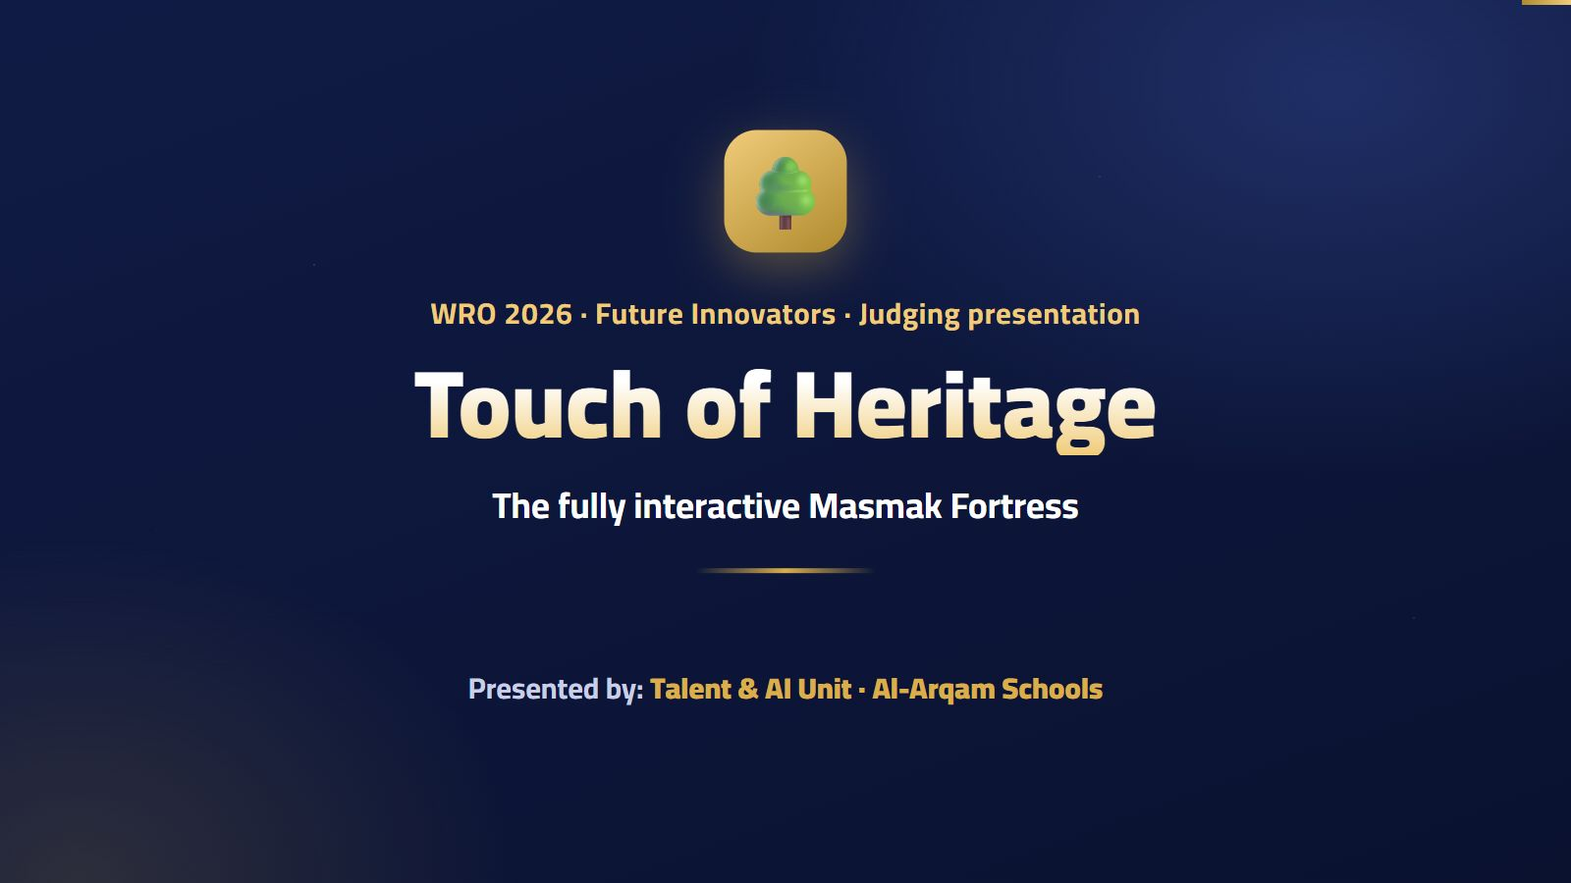
Notes:
Good morning, honorable judges. We are proud to present our project: Touch of Heritage — the fully interactive Masmak Fortress.
💡 هذه الأداة تفاعلية بالكامل في منصة جذور، فاعرضها من المنصة إن أمكن.

Slide 2
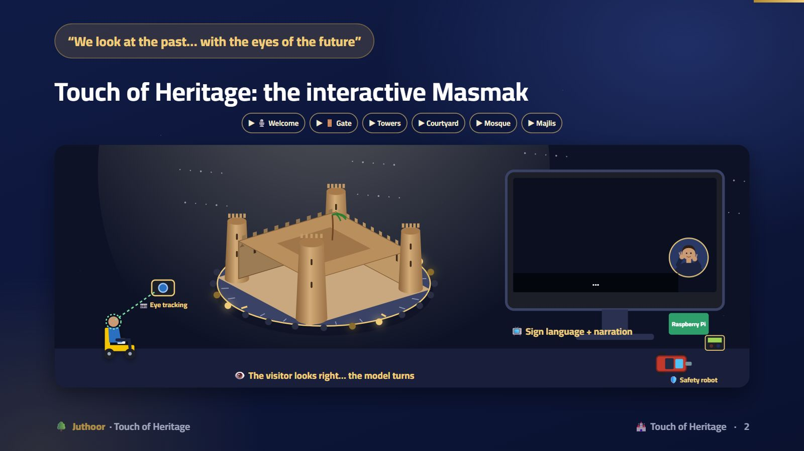
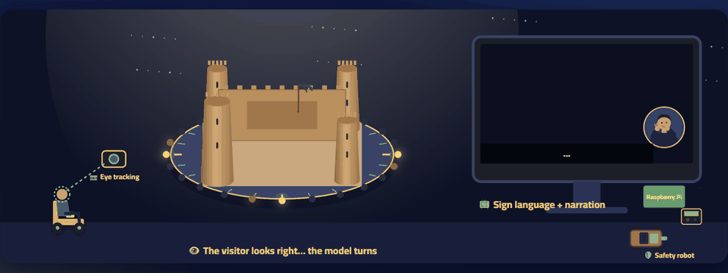
Notes:
Let the scene run: a visitor in a wheelchair in front of a camera. They look right with their eyes and the model turns, with a golden light wave around the turntable. They hold their gaze, the model stops, the face lights up in its color, and a sign-language video with audio narration starts on the screen. Turn the sound on to hear the narrator. Then ask: “Who is in control here?” The answer: only the visitor’s eyes. In the corner, a safety robot guards the exhibition.
🎬 المشهد يتحرك وحده أثناء العرض، وهو تفاعلي بالكامل في منصة جذور.

Slide 3
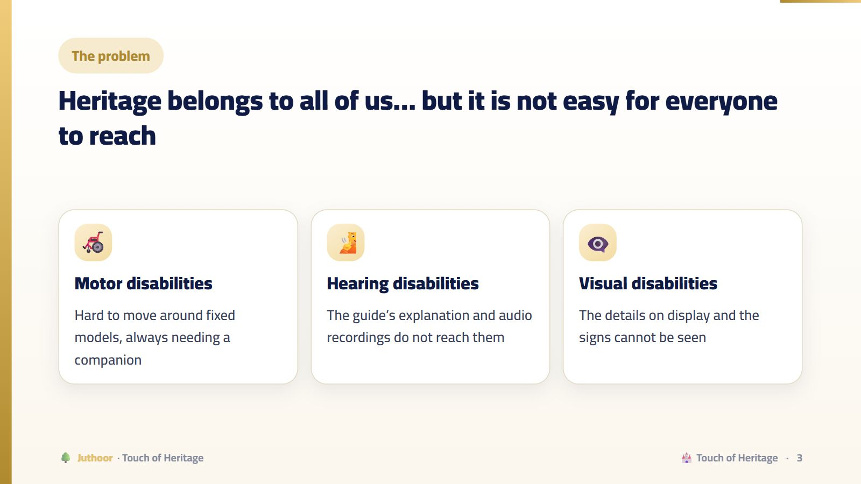
Notes:
Through field visits and talking with people with disabilities, the team noticed that heritage sites are rarely designed for everyone. The need is not three separate solutions, but one smart solution.
💡 هذه الأداة تفاعلية بالكامل في منصة جذور، فاعرضها من المنصة إن أمكن.

Slide 4
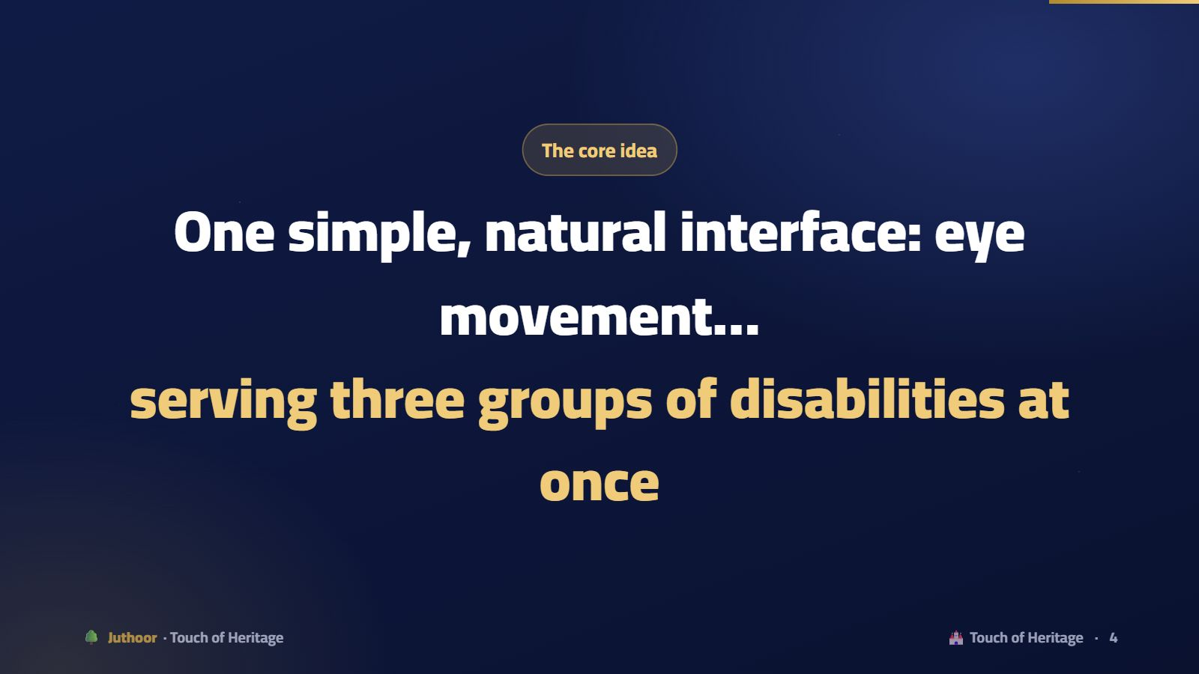
Notes:
Motor: no buttons needing strength or precision. Hearing: a sign-language video. Visual: audio narration. This unified design is what sets the project apart from solutions that treat each disability separately.
💡 هذه الأداة تفاعلية بالكامل في منصة جذور، فاعرضها من المنصة إن أمكن.

Slide 5
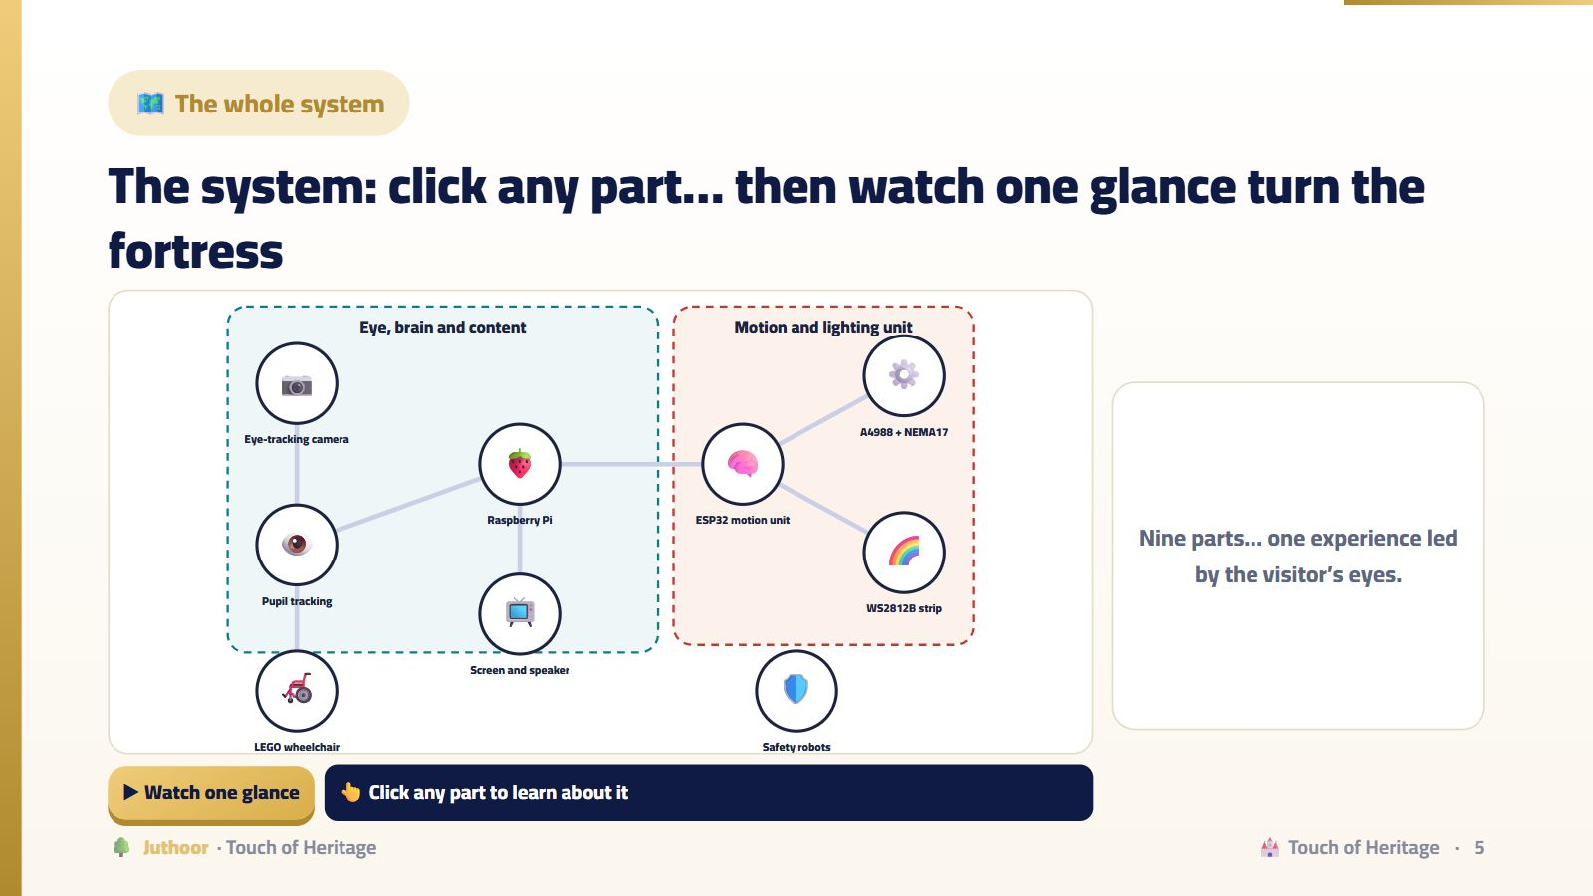
Notes:
Click each node to read its role. Then “Watch one glance”: eight steps from the camera to the sign-language video. Ask: “How many devices took part in one glance?” Four: the camera and computer, the Raspberry Pi, the ESP32 and the driver.
💡 هذه الأداة تفاعلية بالكامل في منصة جذور، فاعرضها من المنصة إن أمكن.

Slide 6
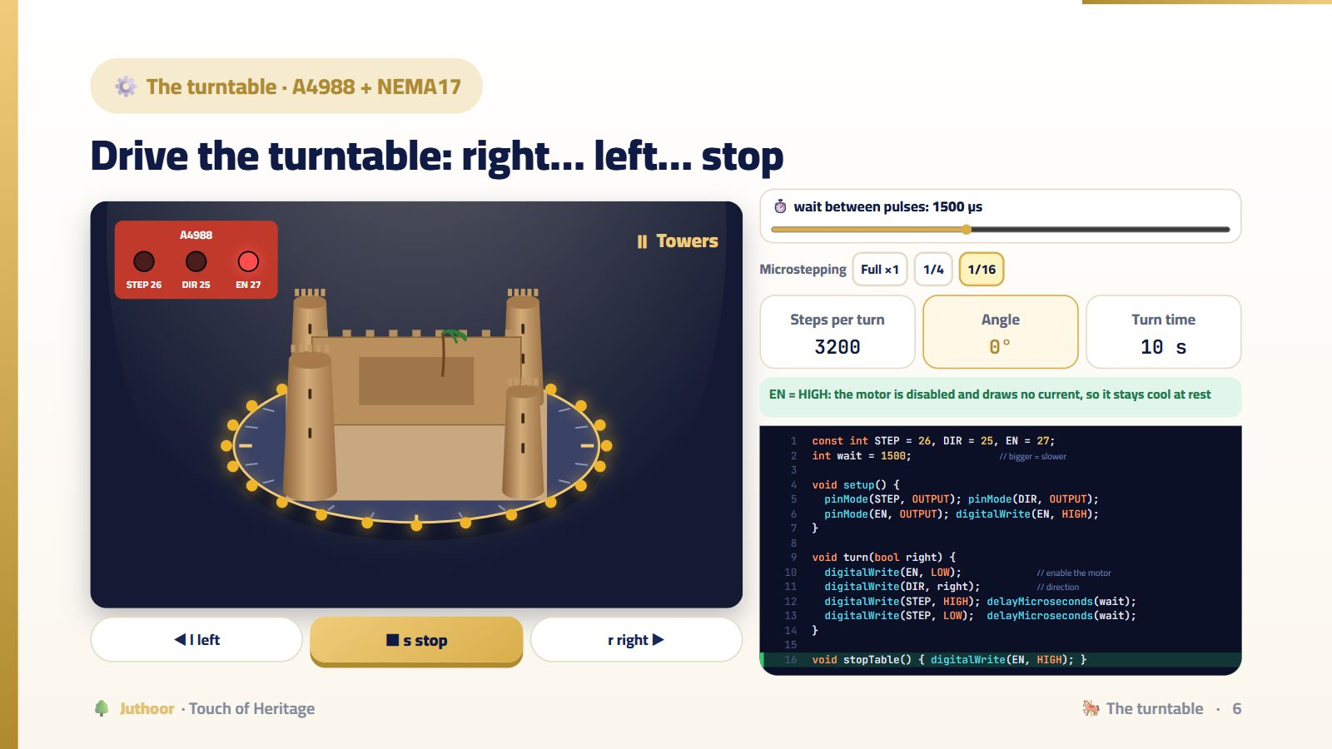
Notes:
Press r right: the STEP LED blinks with every pulse, DIR is on, the model turns and a golden wave runs around it. Press s: EN goes HIGH and the face name appears. Change wait: bigger = slower. Then choose “Full ×1” and lower wait below 700: the motor loses steps and shakes. Microstepping makes the motion smooth for the eye to follow.
💡 هذه الأداة تفاعلية بالكامل في منصة جذور، فاعرضها من المنصة إن أمكن.

Slide 7
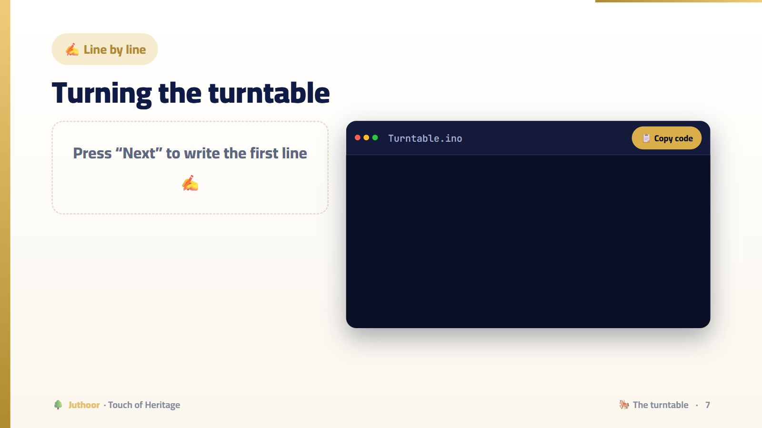
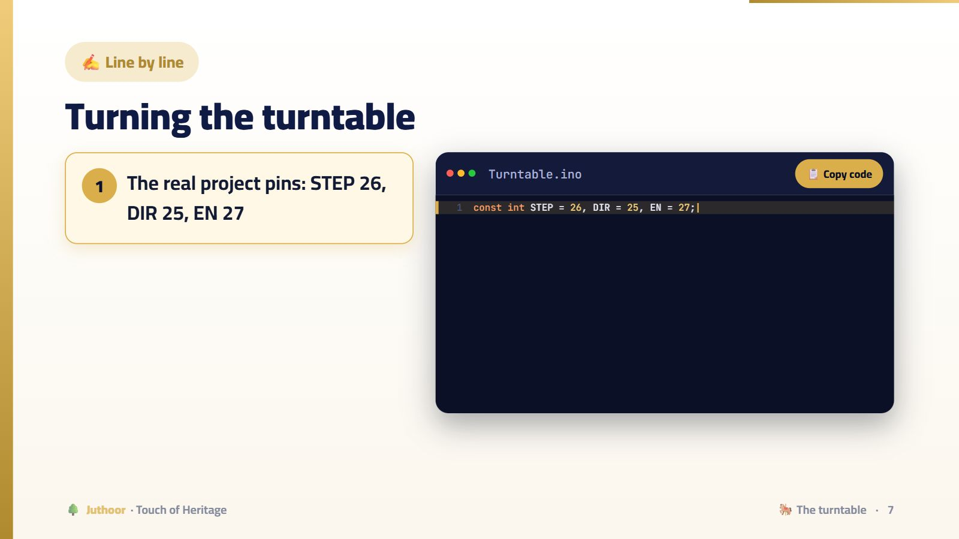
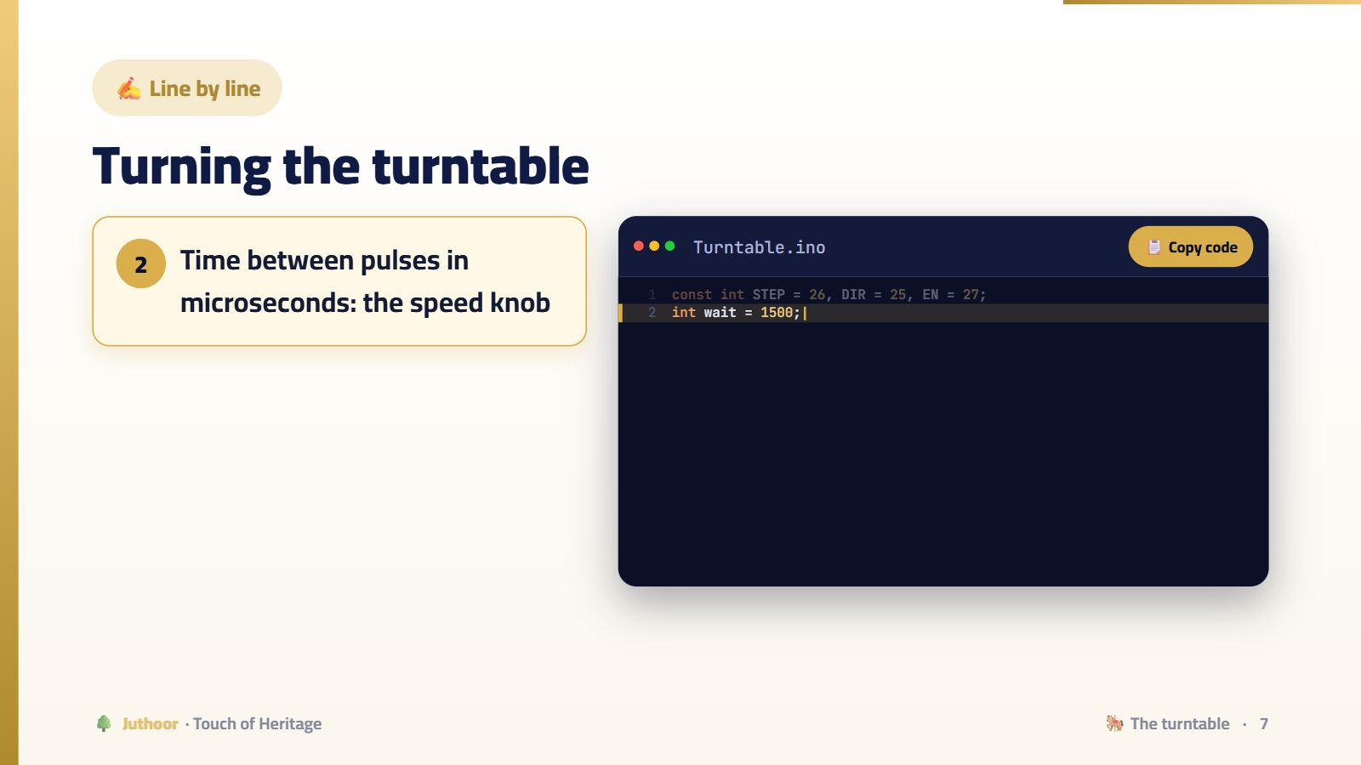
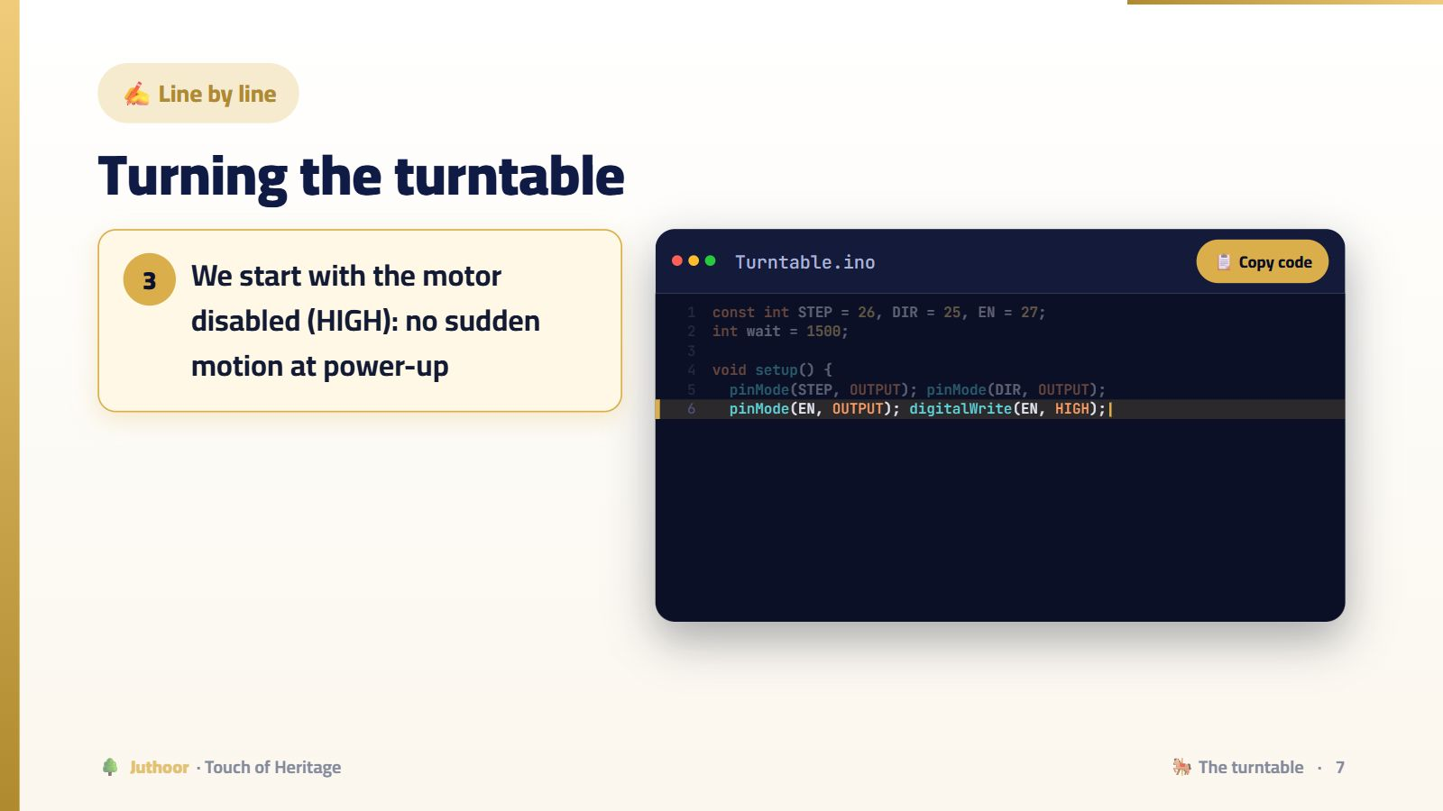
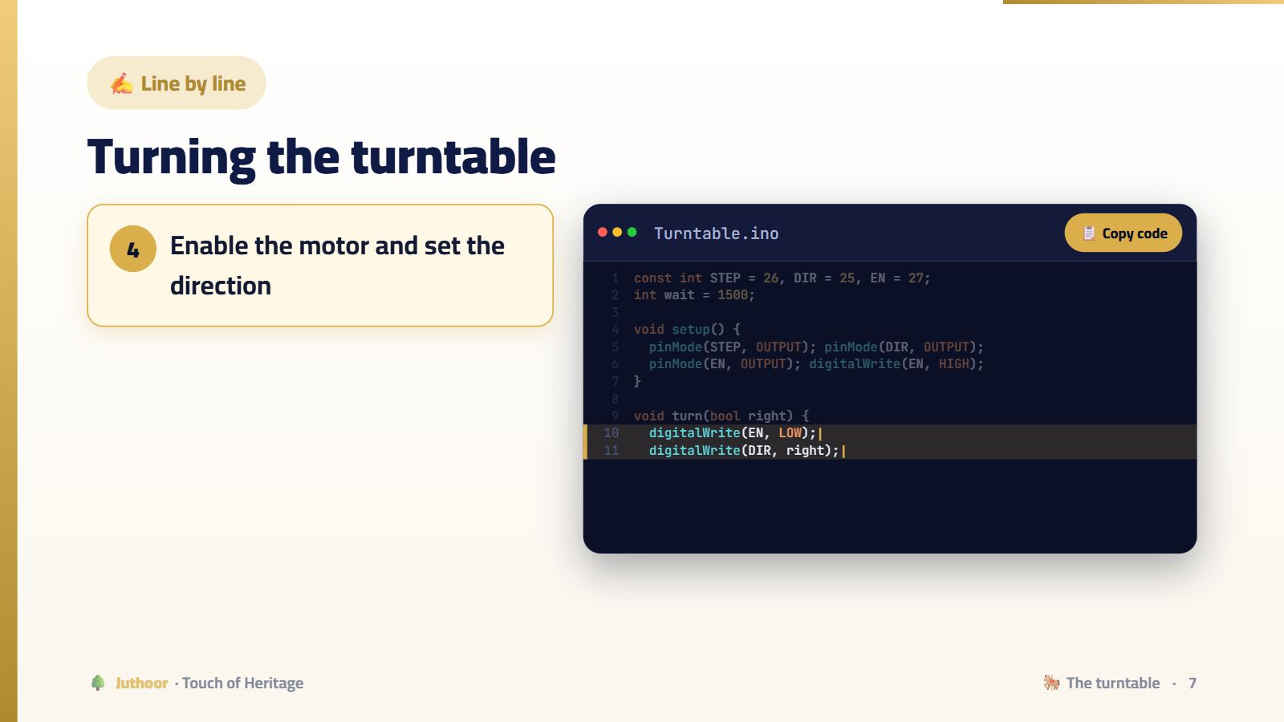
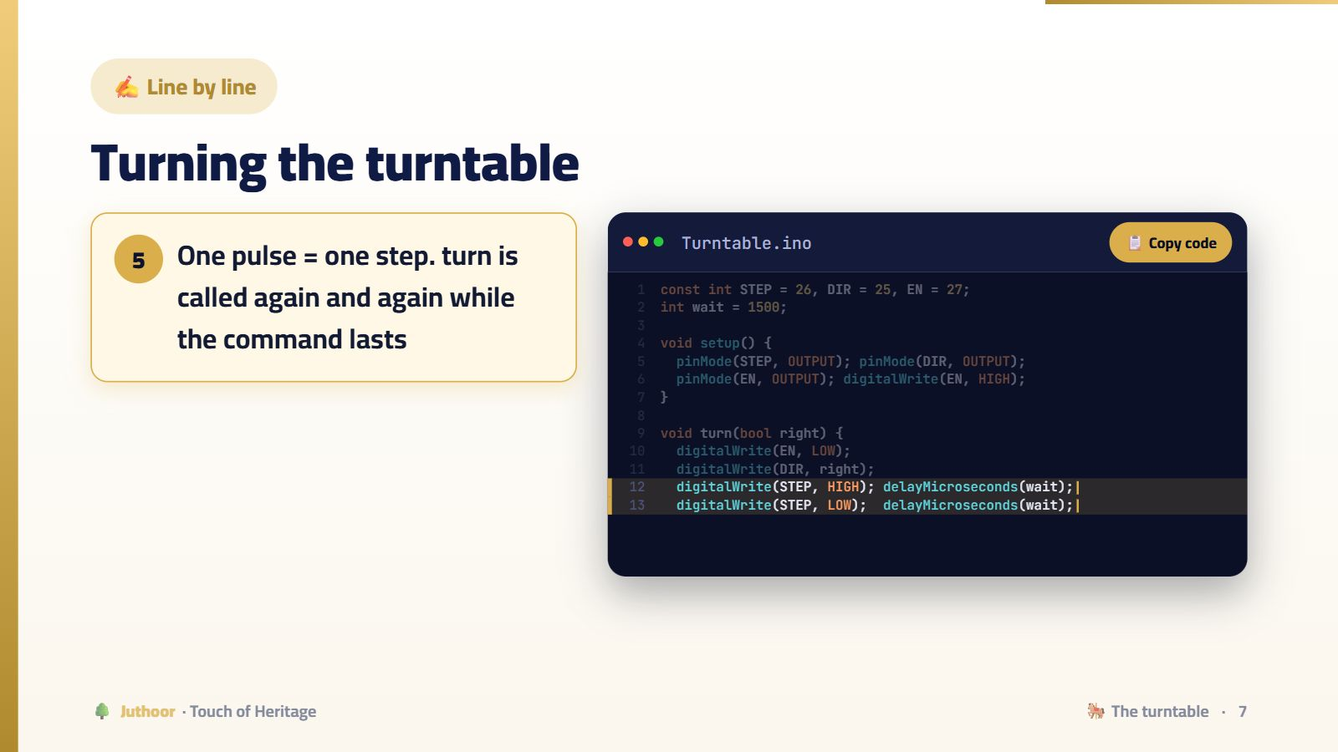

Notes:
turn takes only one step, and loop calls it thousands of times. That keeps the ESP32 free to read new commands between steps.
🖱️ اضغط للانتقال بين الخطوات.

Slide 8
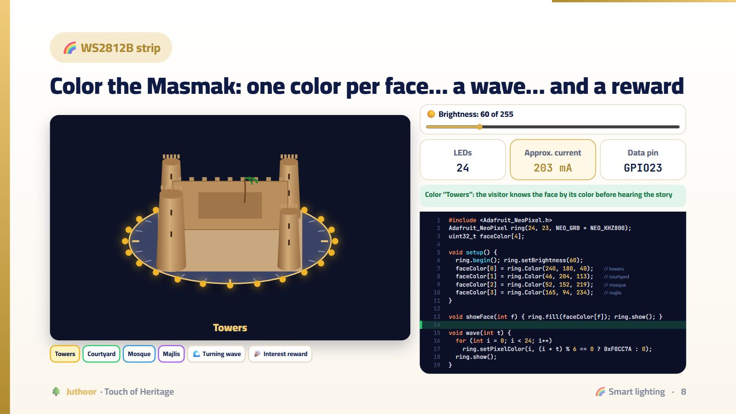
Notes:
Press each face: the turntable turns to it and the strip takes its color. Then “Turning wave”. Then “Interest reward”: an idea the team is developing, for when a visitor looks at a face for a long time. Raise the brightness to 255 and watch the current: that is why the team limited the brightness for safety.
💡 هذه الأداة تفاعلية بالكامل في منصة جذور، فاعرضها من المنصة إن أمكن.

Slide 9
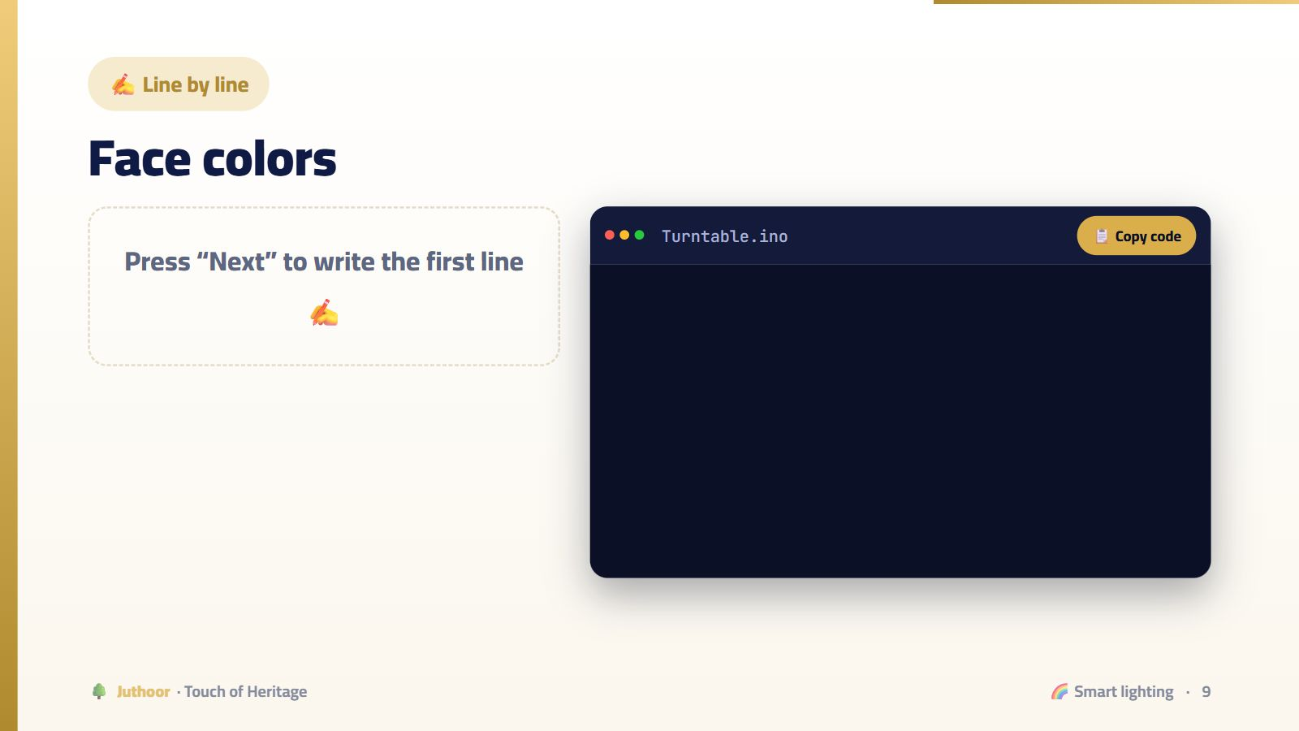

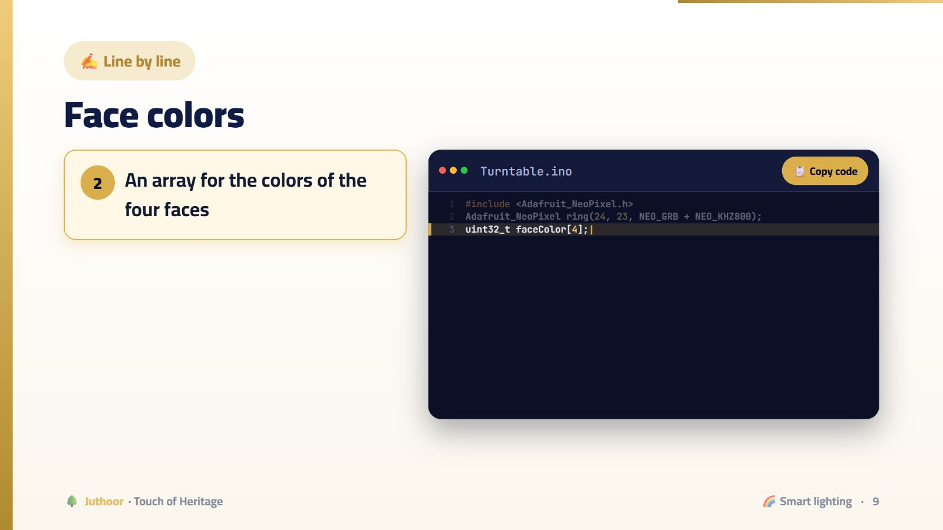

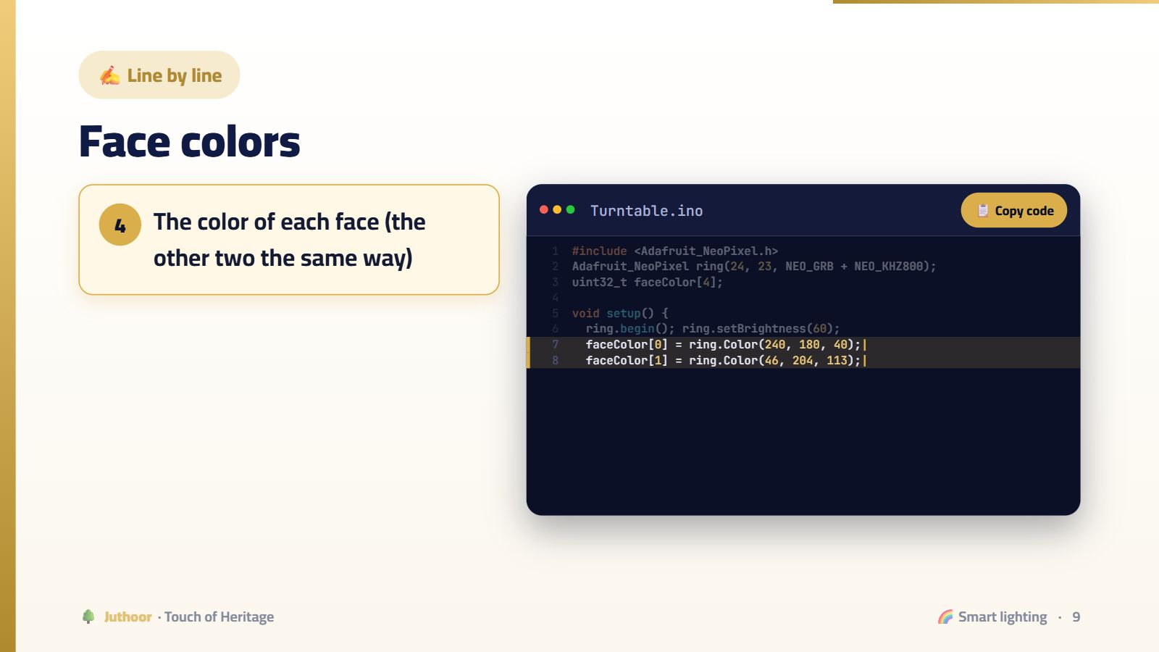

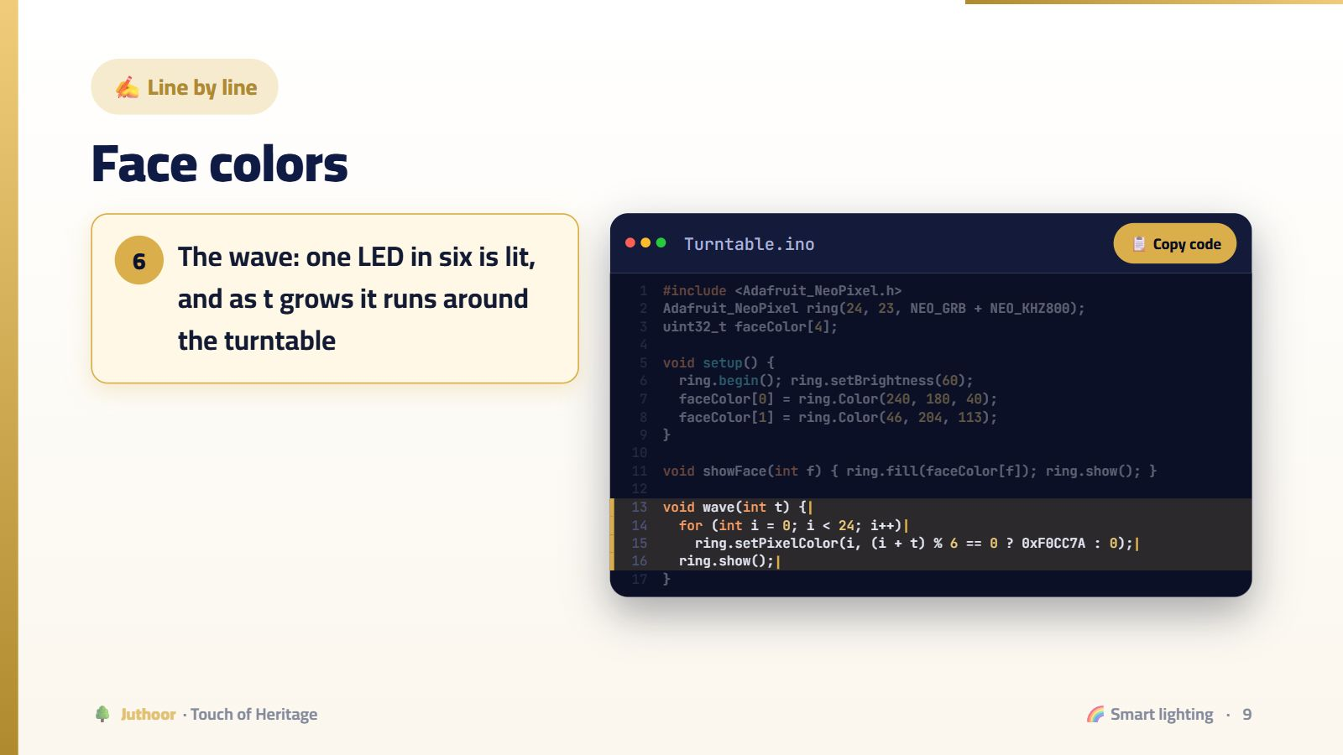
Notes:
Nothing changes before show! A common mistake: students set the colors, forget show, and see nothing.
🖱️ اضغط للانتقال بين الخطوات.

Slide 10
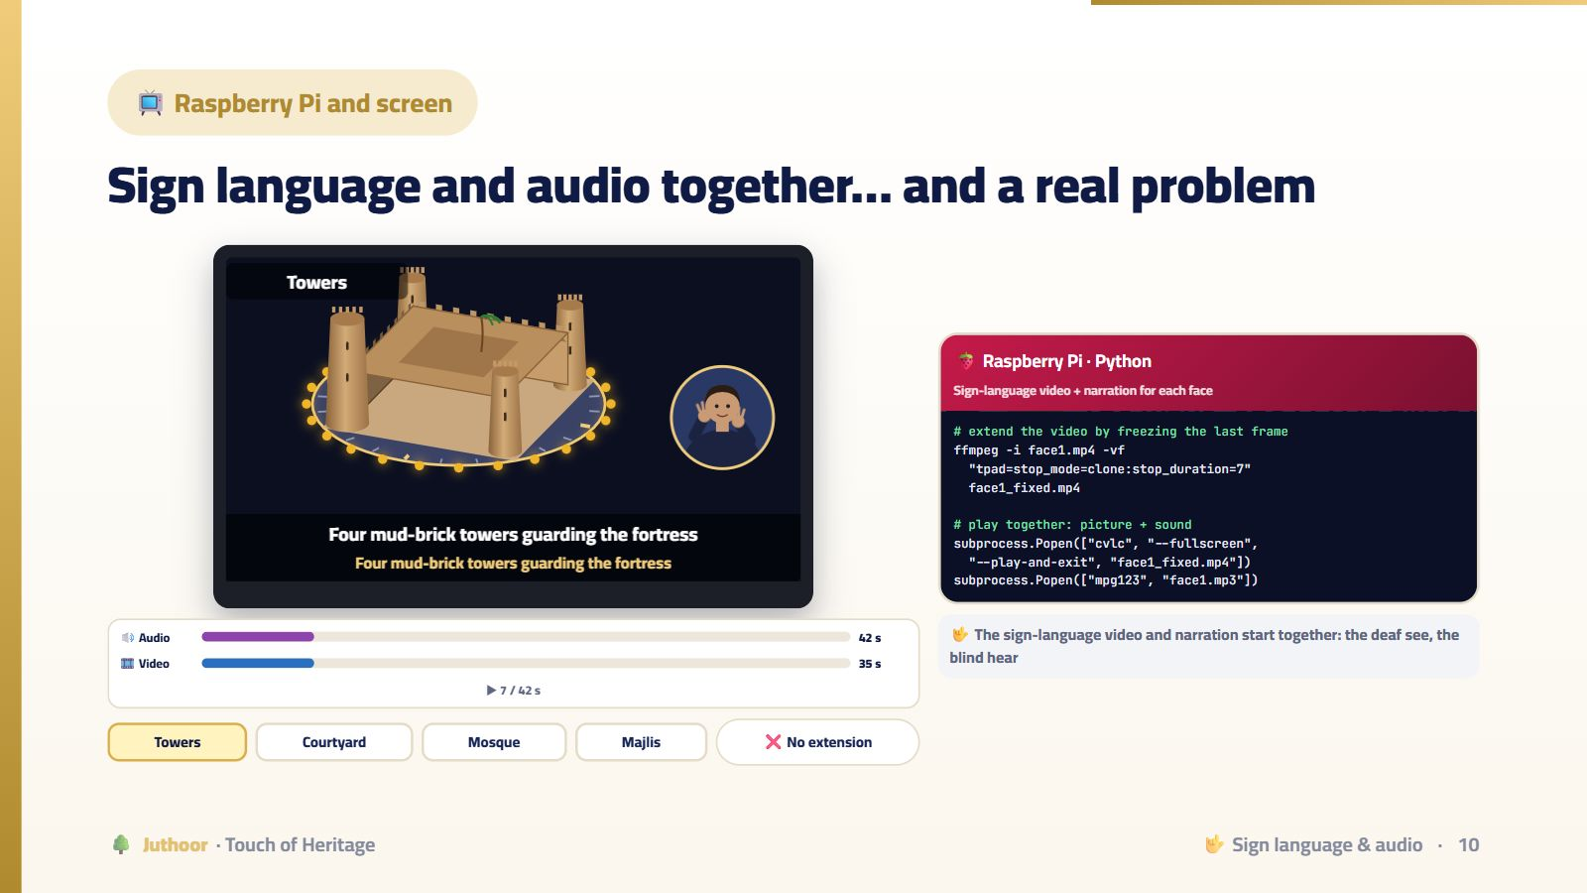
Notes:
Choose a face and watch the two bars: the audio is longer than the video! Without extension, the video ends, the screen goes black while the audio continues, and the deaf visitor loses the interpreter. This really happened to the team: differences of 2 to 11 seconds. Press “Extend with last frame”: the picture stays until the audio ends — one ffmpeg command, keeping the originals as a backup.
💡 هذه الأداة تفاعلية بالكامل في منصة جذور، فاعرضها من المنصة إن أمكن.

Slide 11
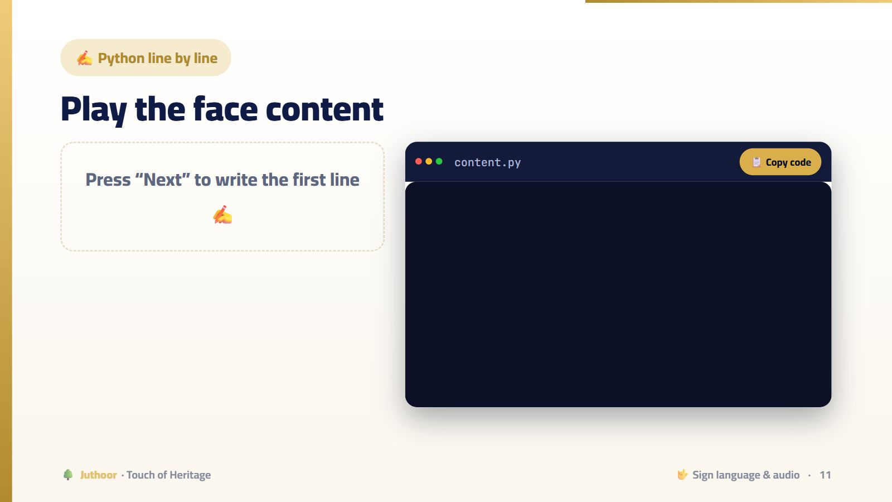
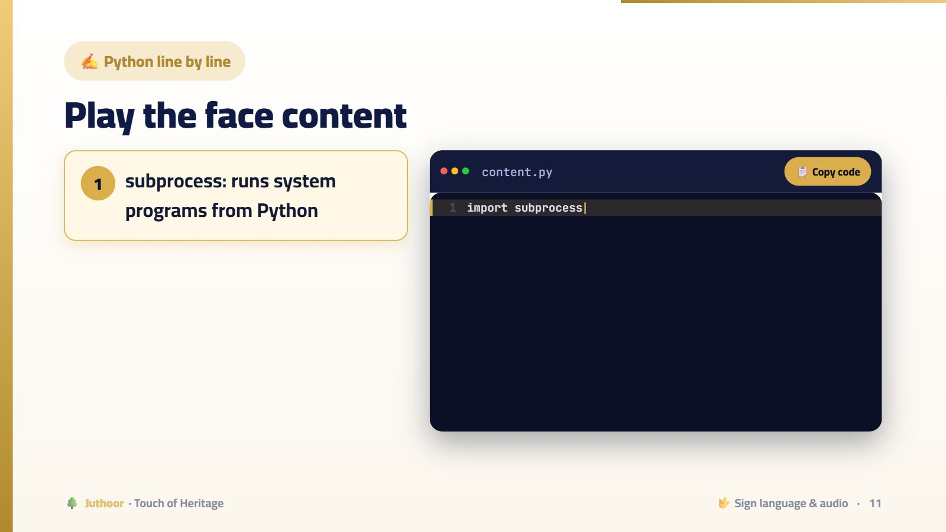
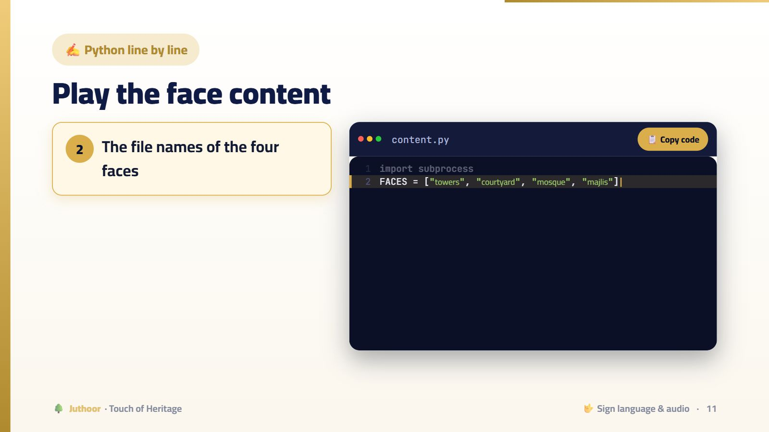
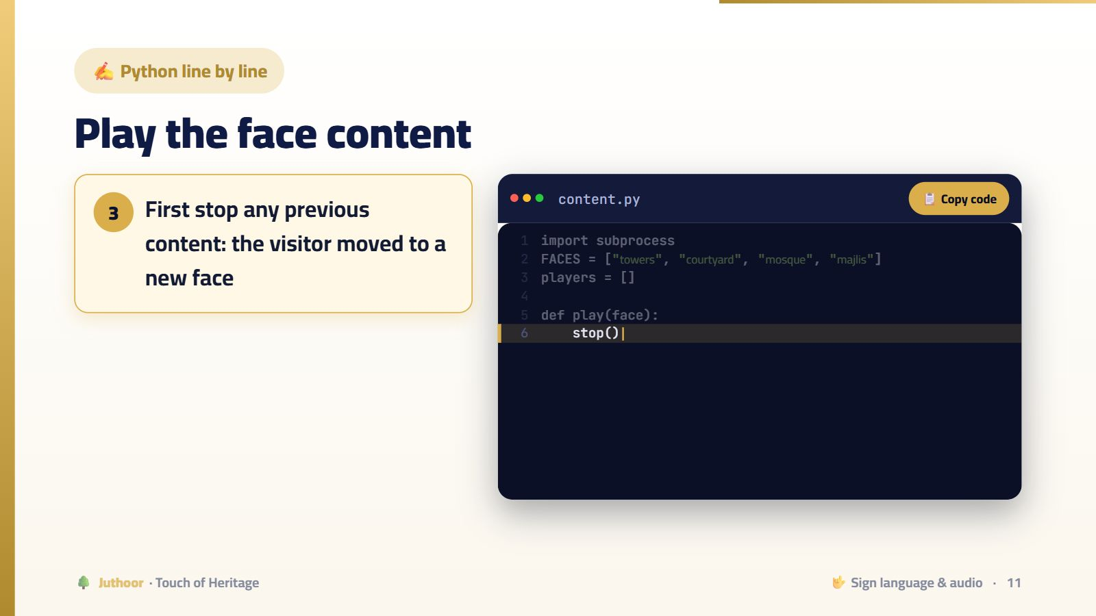
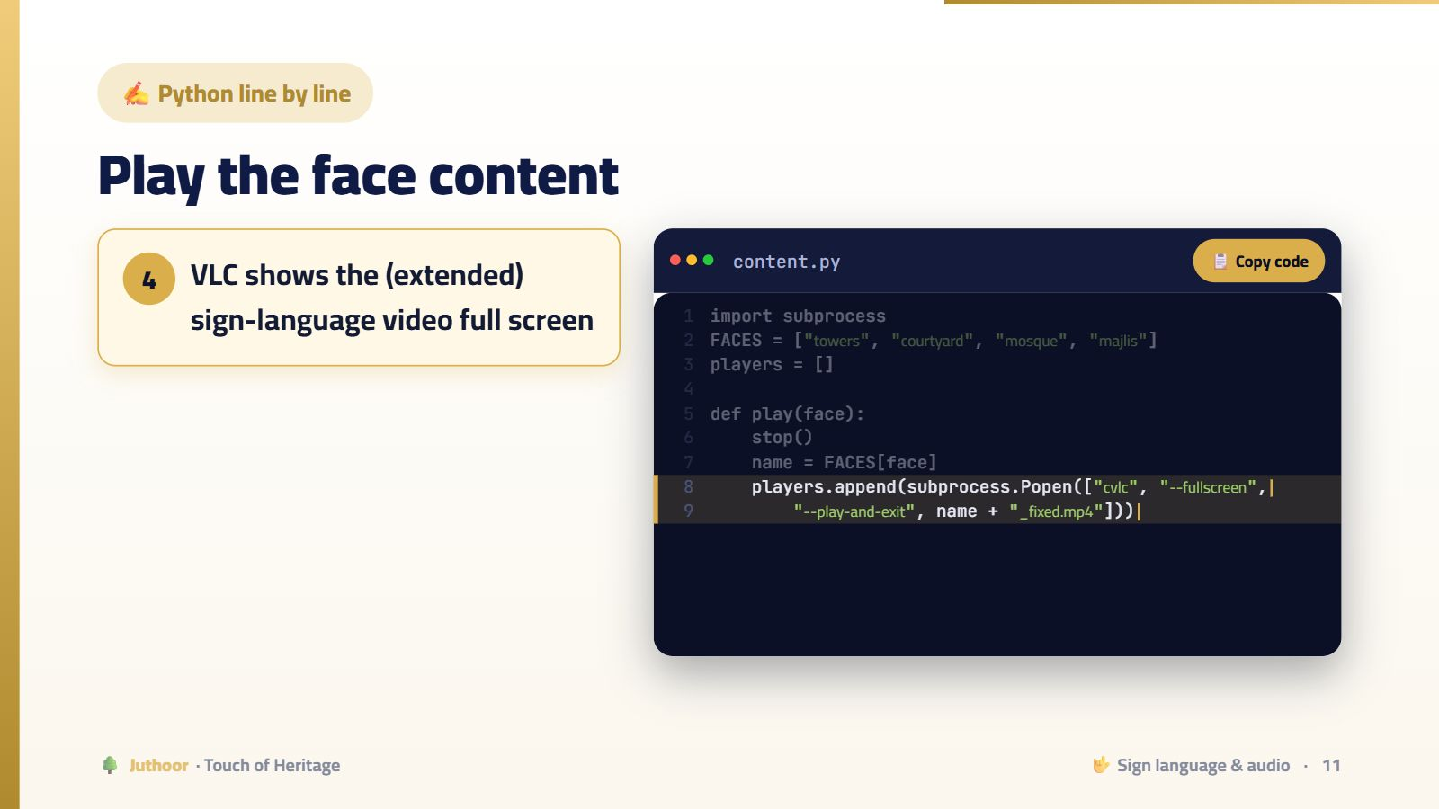

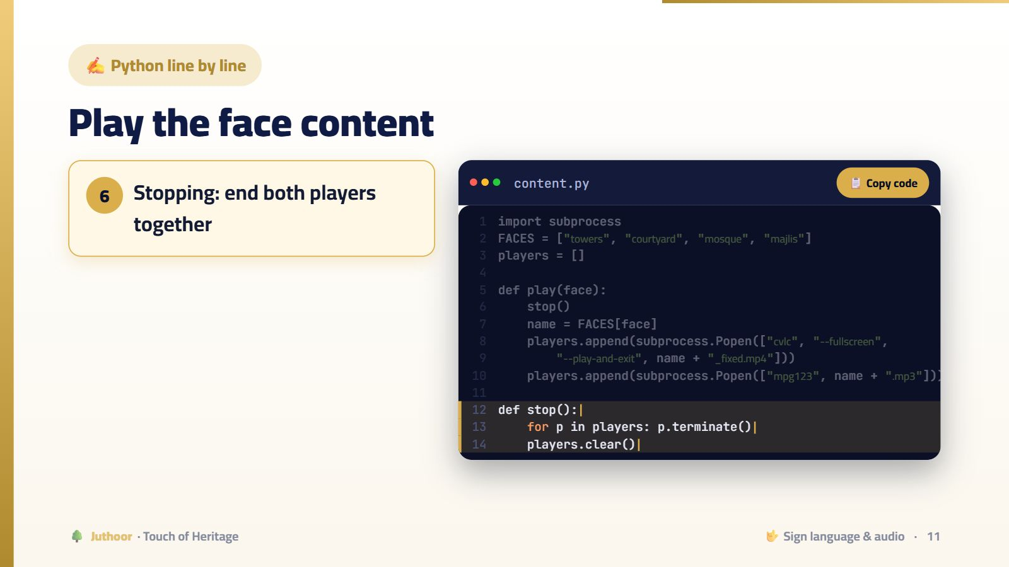
Notes:
Popen does not wait for the program to finish, so video and audio play together and Python stays free for eye commands.
🖱️ اضغط للانتقال بين الخطوات.

Slide 12
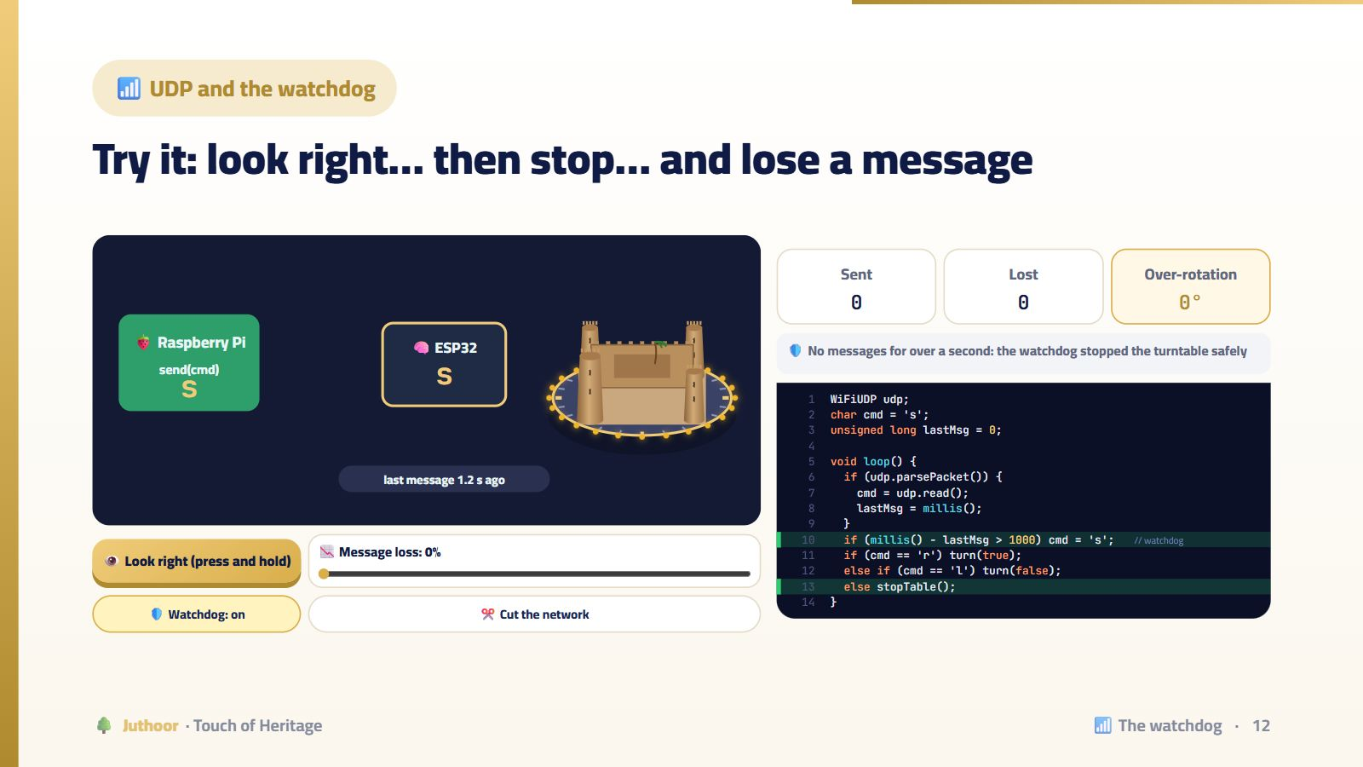
Notes:
Press and hold “Look right”: r messages fly every 100 ms. Release: s messages. Now raise the loss to 40%, turn off the watchdog and repeat: sometimes the s messages are lost and the turntable keeps turning! The team found this in the logs: one lost message caused far more rotation than intended. Then turn the watchdog on: if no message arrives for more than a second, the turntable stops safely. Finally, “Cut the network” with the watchdog on.
💡 هذه الأداة تفاعلية بالكامل في منصة جذور، فاعرضها من المنصة إن أمكن.

Slide 13
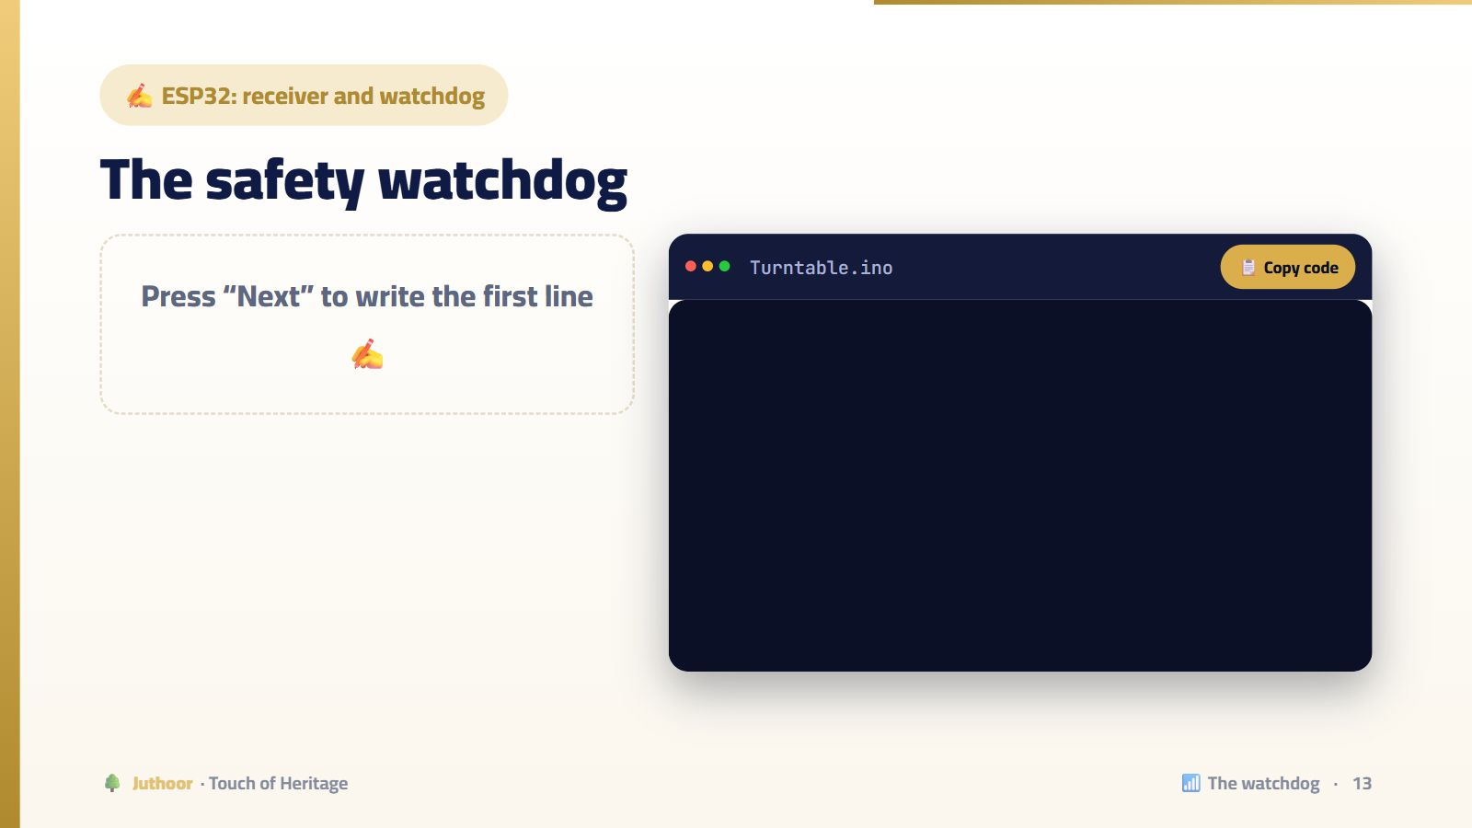
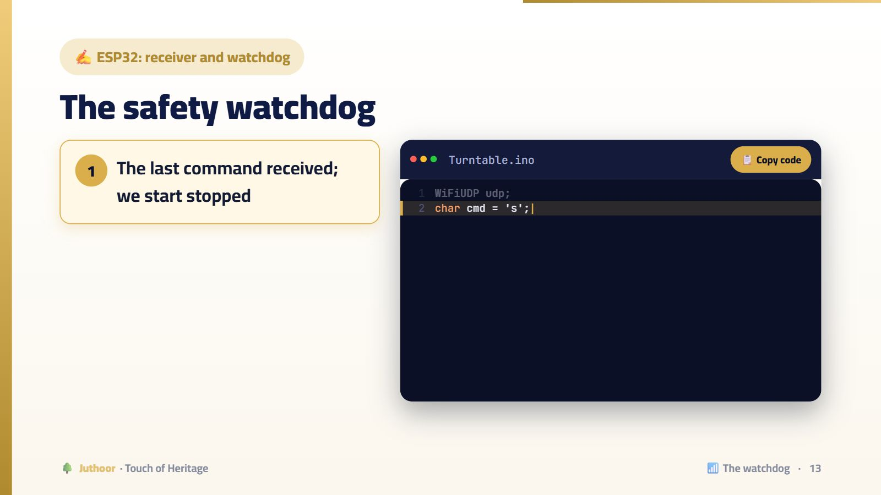
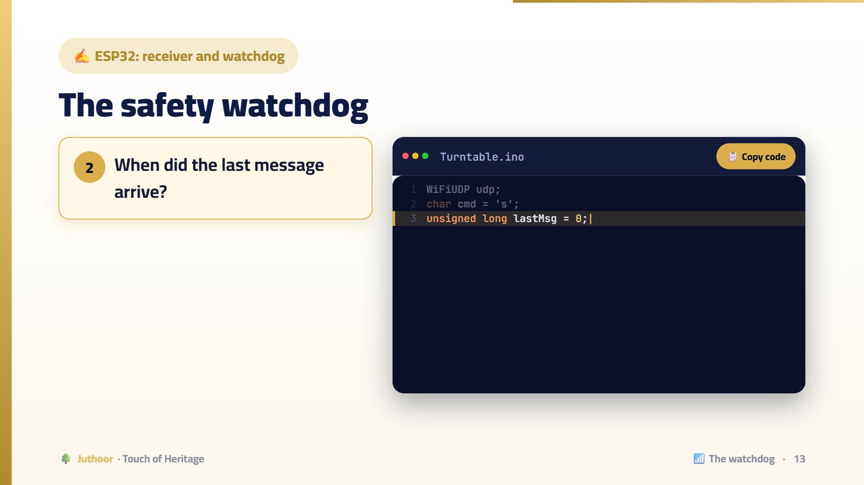
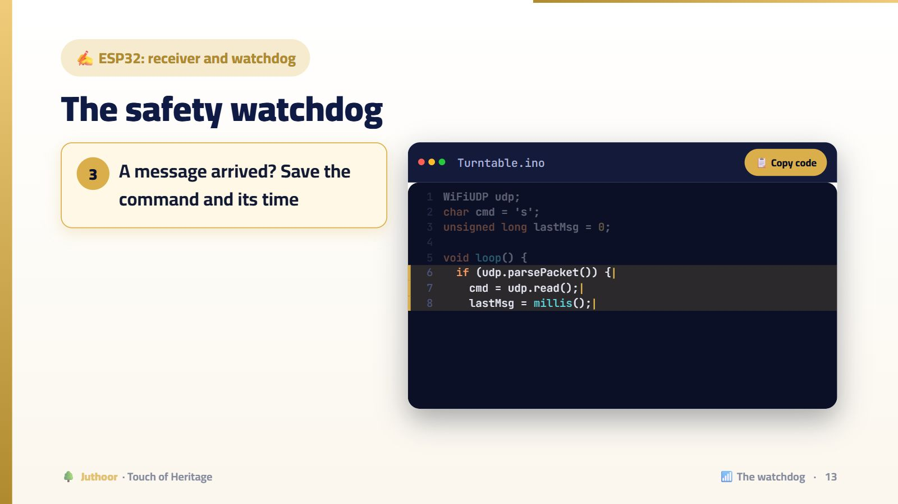
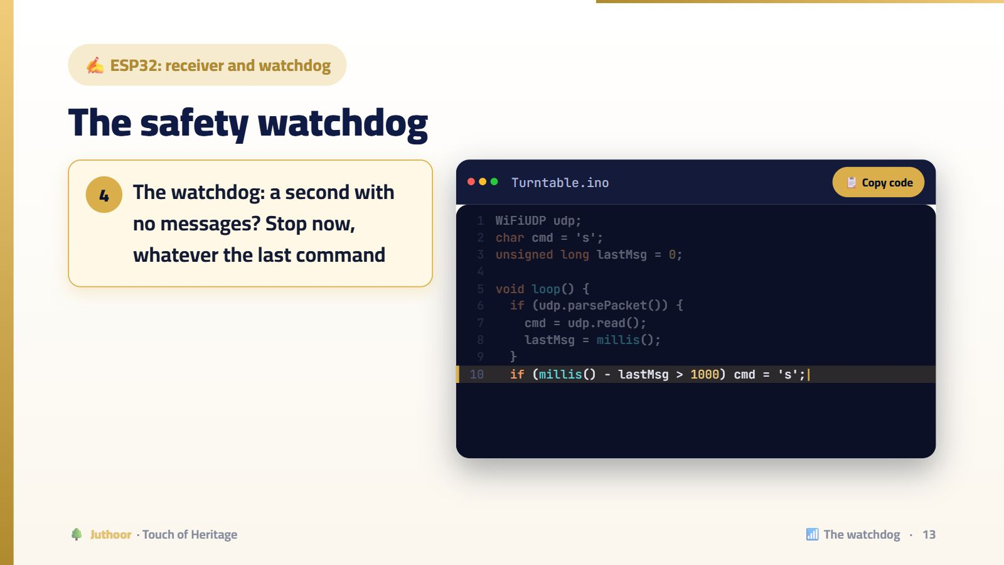
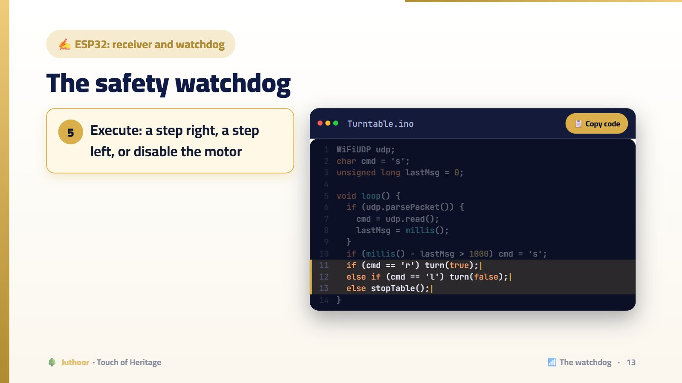
Notes:
Why does the watchdog work? Because the sender repeats the command continuously. So a long silence does not mean “keep going”, it means “something went wrong”. This is the fail-safe principle used in planes, trains and elevators.
🖱️ اضغط للانتقال بين الخطوات.

Slide 14
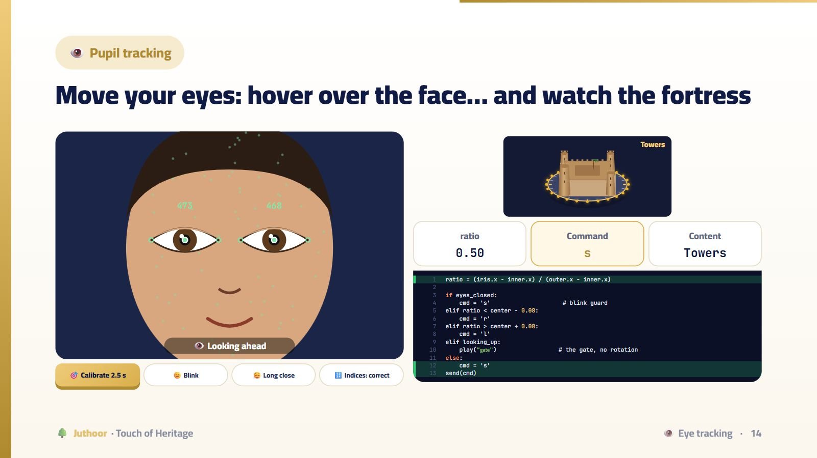
Notes:
Press “Calibrate” first. Then move the pointer right and left over the face: the pupil moves, the ratio changes, the command is r or l, and the fortress turns. Back to the center: s, and the face content starts. Move up: the gate, without turning. Press “Blink”: an instant safety stop. And “Long close”: “explain this face”. Finally, “Indices: documented”: the directions flip! The team really found that indices 468 and 473 were reversed compared to common sources.
💡 هذه الأداة تفاعلية بالكامل في منصة جذور، فاعرضها من المنصة إن أمكن.

Slide 15
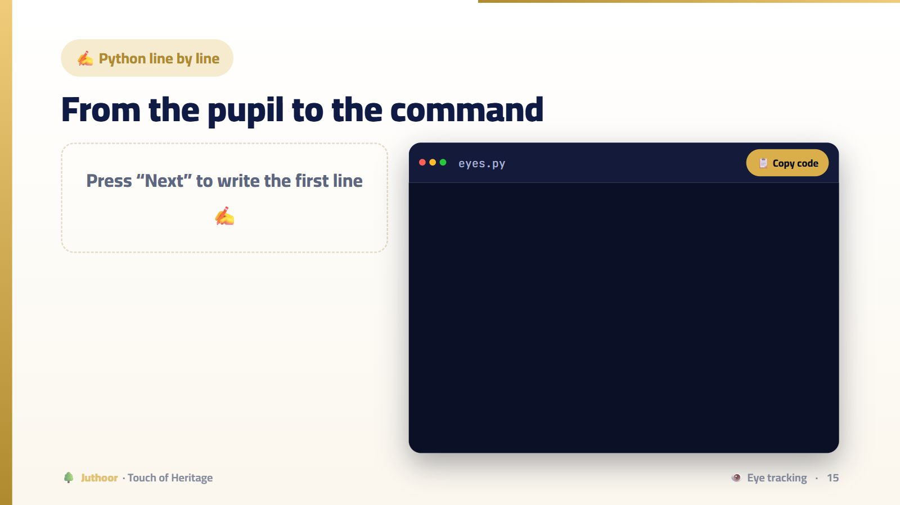
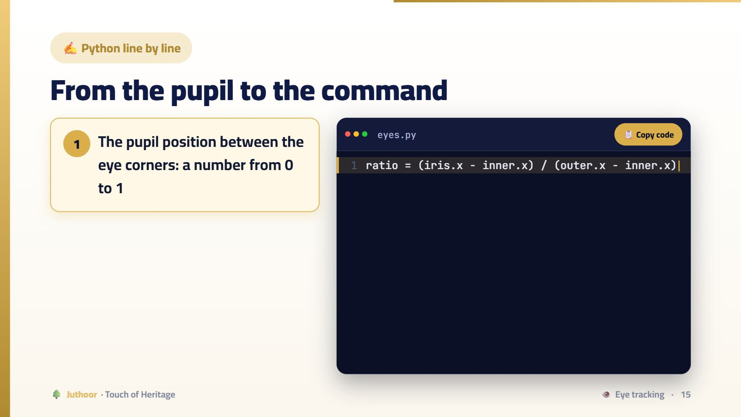
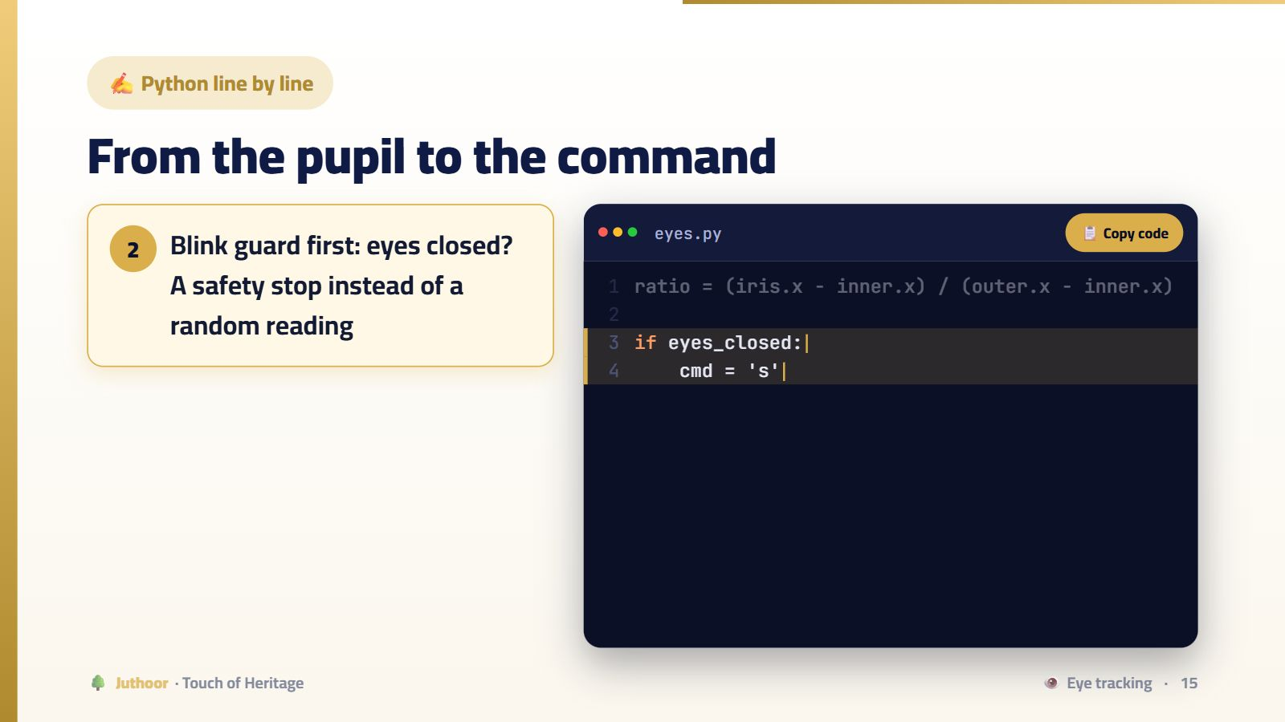
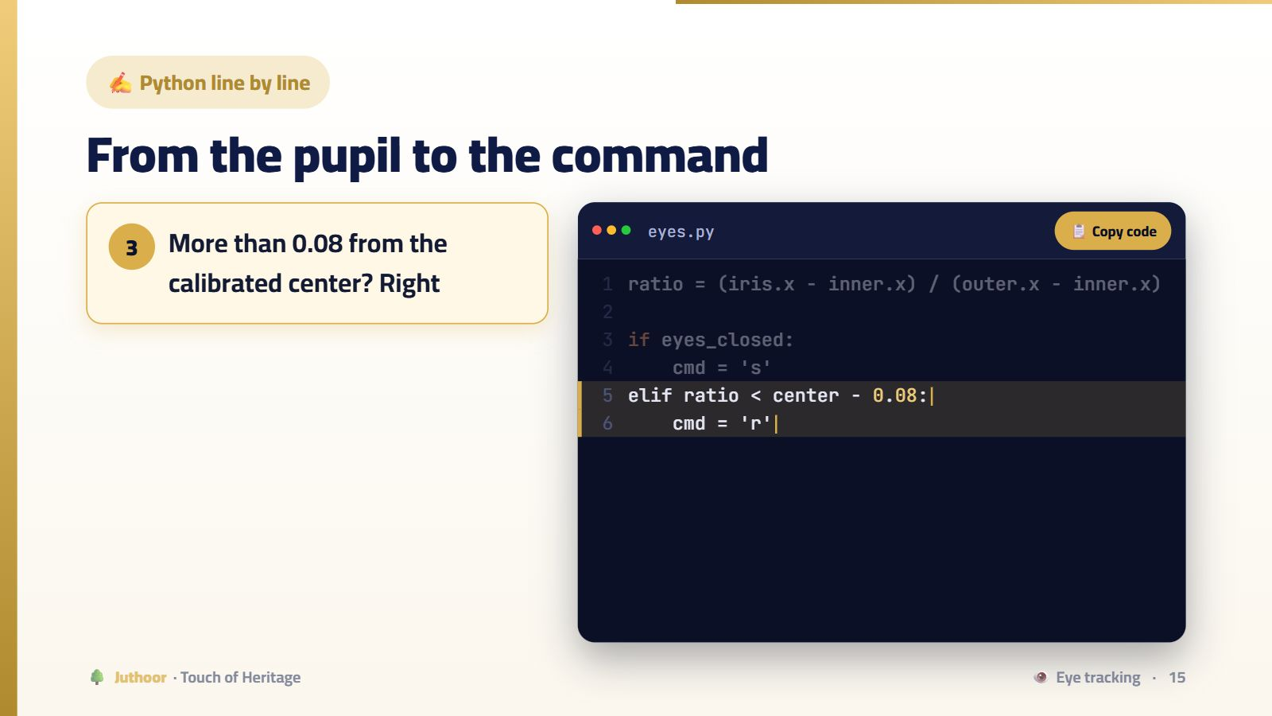
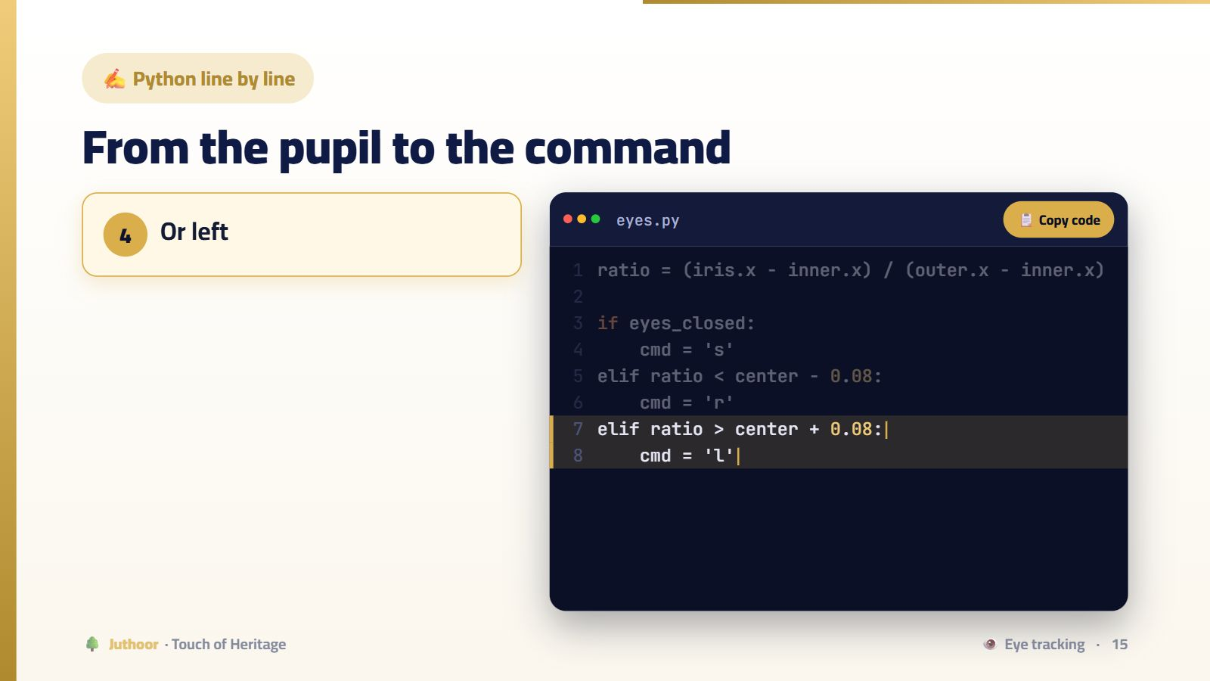
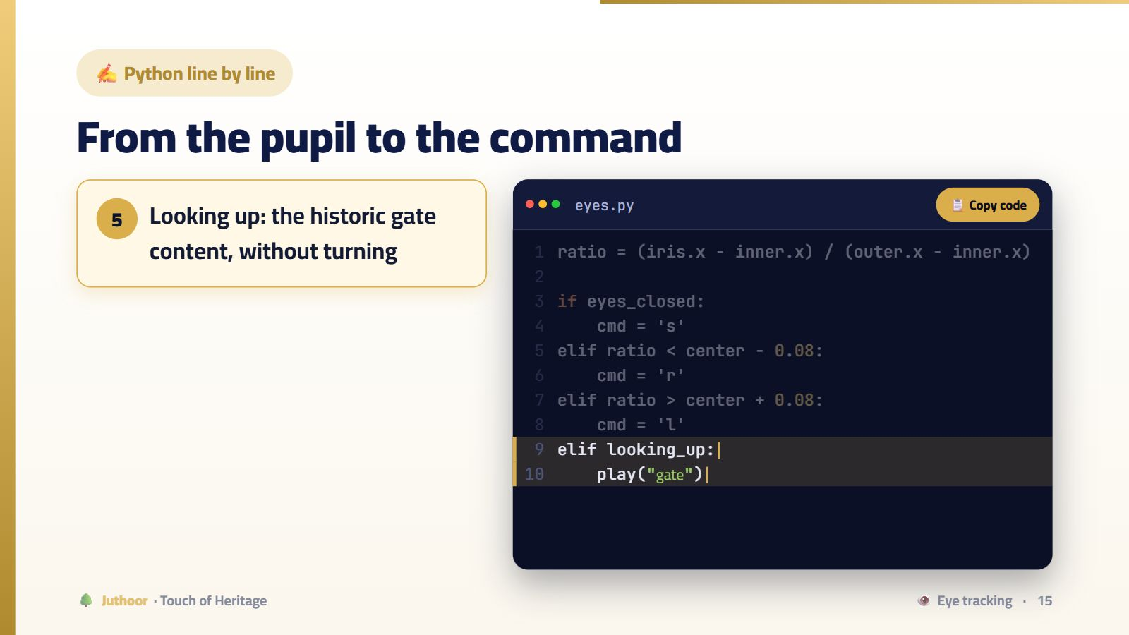
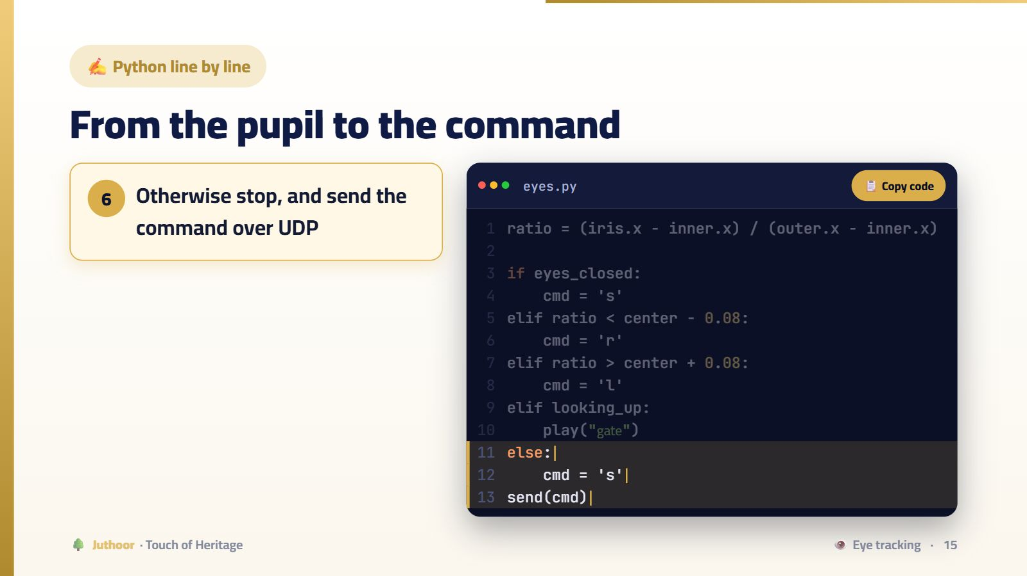
Notes:
The 0.08 margin is a “dead zone”: a natural forward gaze has small jitters that should not move the turntable. A deliberate long close (longer than a blink) means “explain this face”.
🖱️ اضغط للانتقال بين الخطوات.

Slide 16
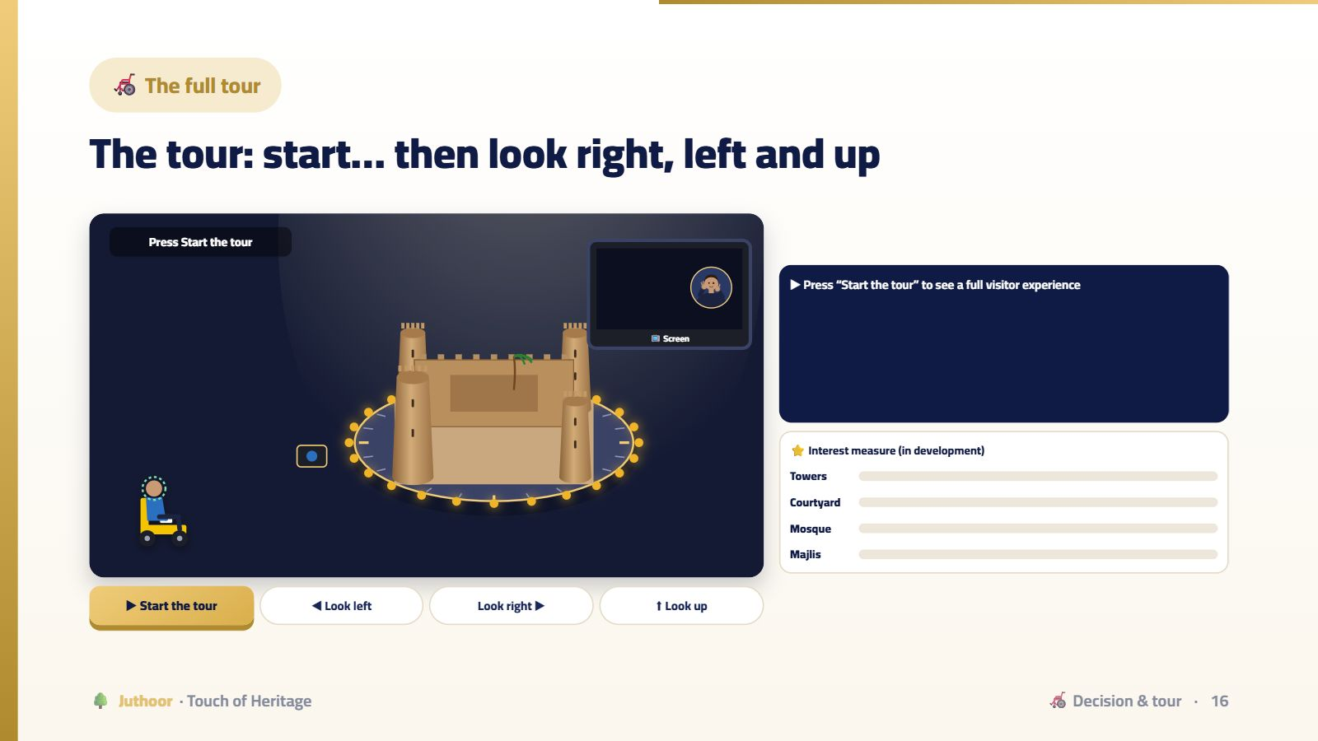
Notes:
Press “Start the tour”: a welcome, then the chair moves forward and the distance sensor measures, then “explore mode”. Press and hold “Look right”: the fortress turns. Release: it stops, the face content starts, and the interest bar fills. Look at one face for a long time: celebration lights. Visit all four faces: the tour summary. These two features are in development by the team; the simulator shows how they will work.
💡 هذه الأداة تفاعلية بالكامل في منصة جذور، فاعرضها من المنصة إن أمكن.

Slide 17
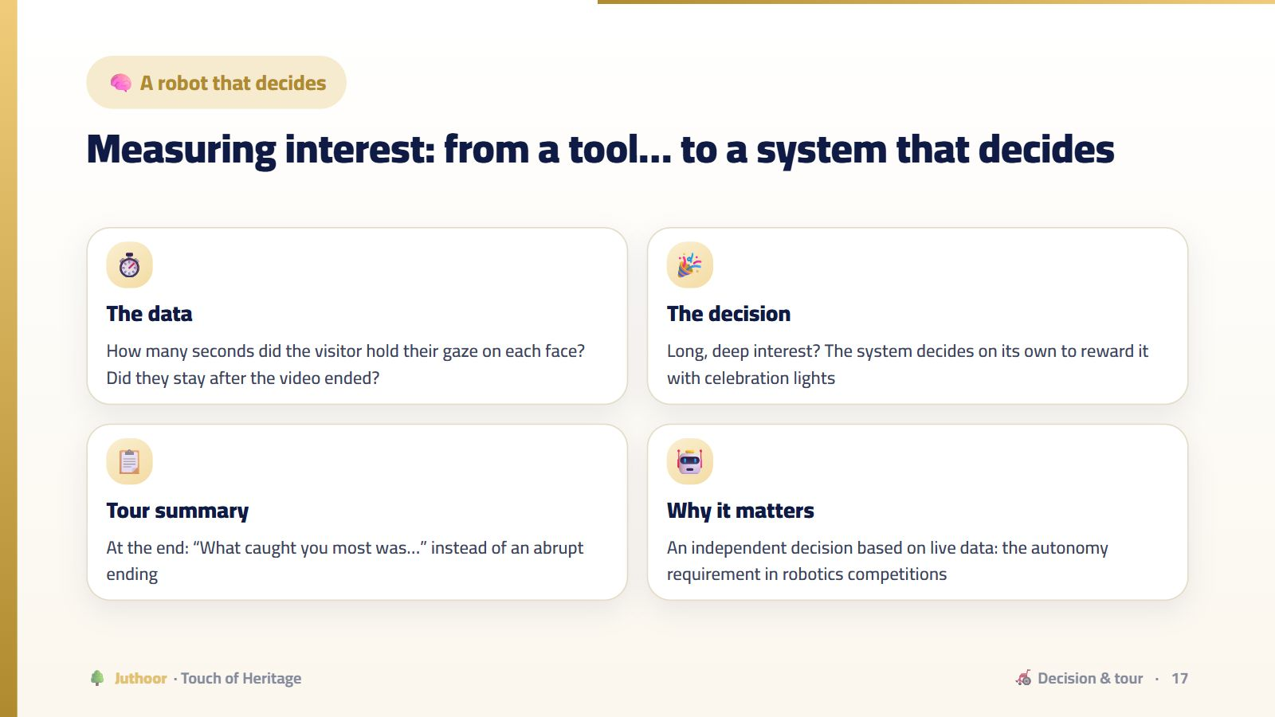
Notes:
This is the difference between a robot that “responds to a command” and a robot that “makes a decision”.
💡 هذه الأداة تفاعلية بالكامل في منصة جذور، فاعرضها من المنصة إن أمكن.

Slide 18
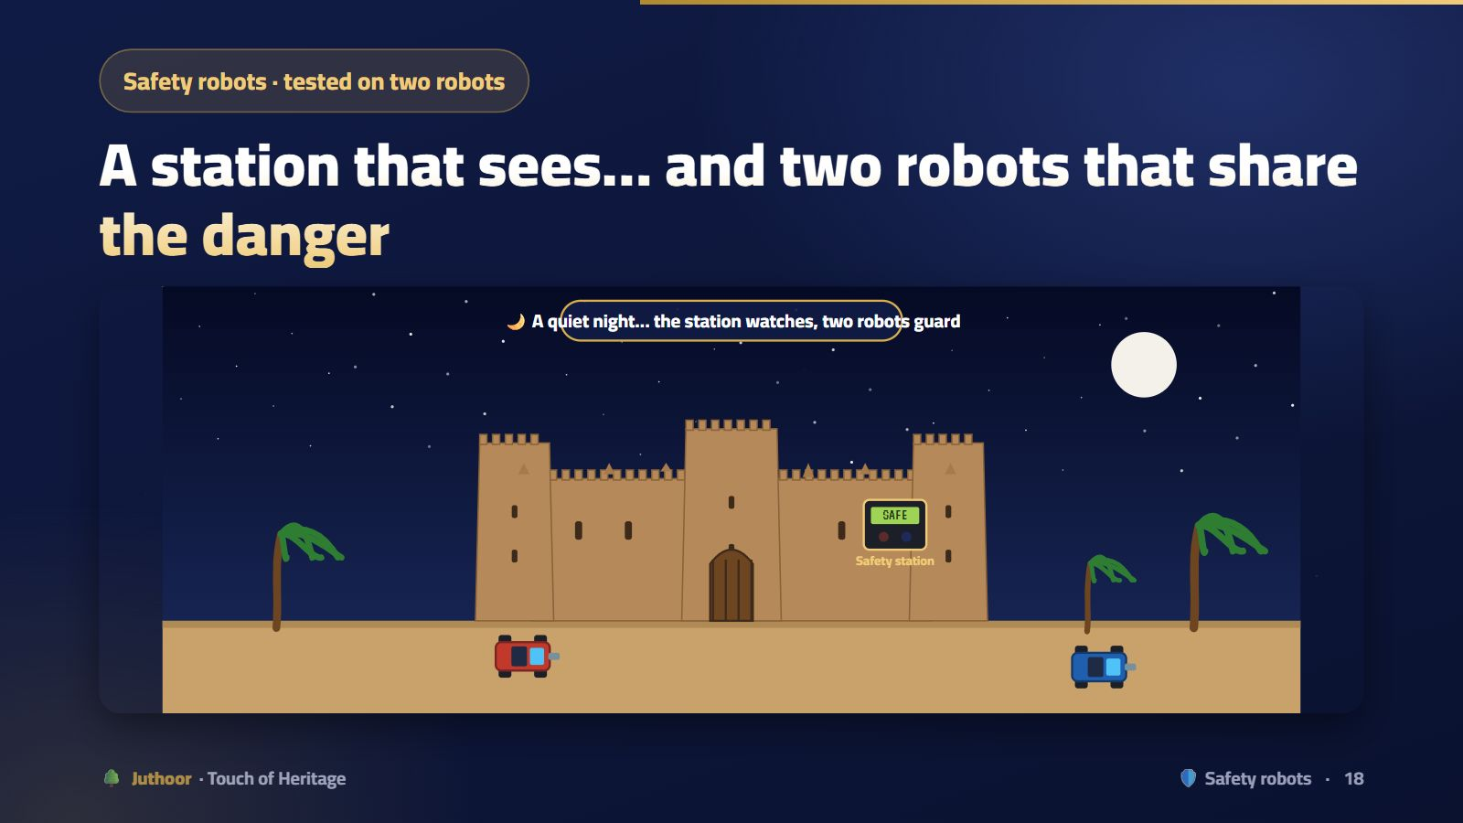
Notes:
Let the scene run: a flame at the tower and a gas leak at the same moment. The leader goes to the fire itself (it carries the pump), and sends robot 2 to the gas (it carries the fan). They set off together, and when they finish, each one backs up to its place the same way. Two robots are faster than one robot handling both dangers in turn.
💡 هذه الأداة تفاعلية بالكامل في منصة جذور، فاعرضها من المنصة إن أمكن.

Slide 19
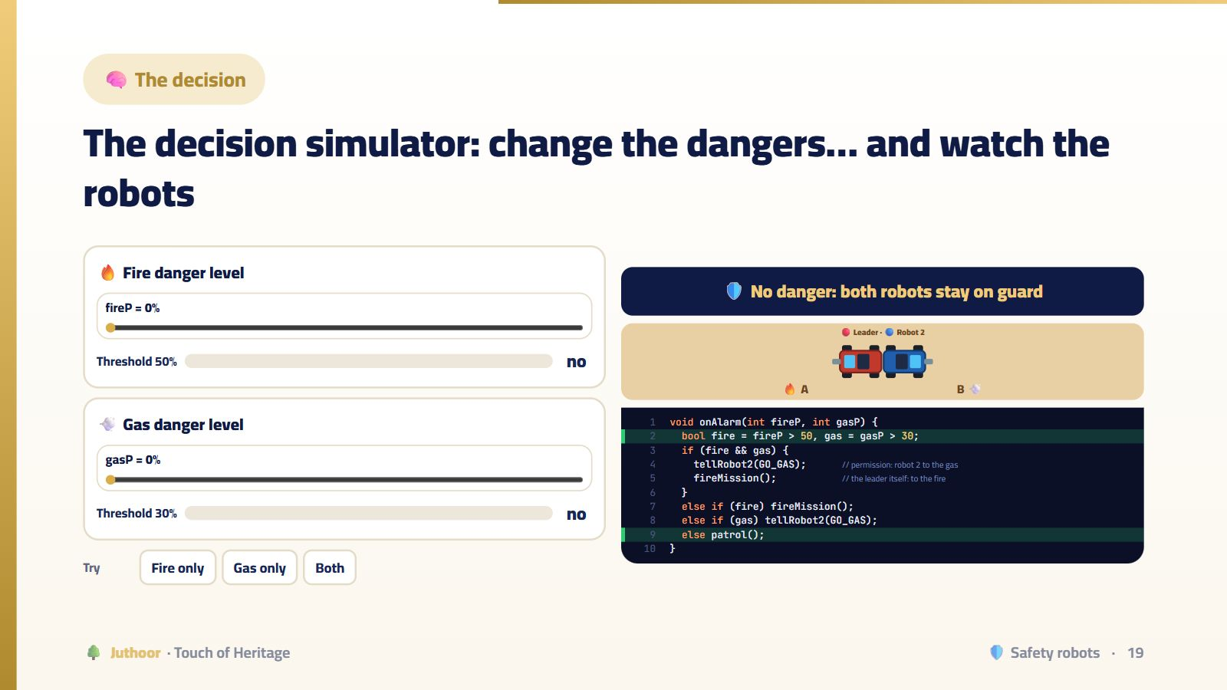
Notes:
Try the three buttons: fire only (the leader goes and backs up, robot 2 keeps guard), then gas only (the leader stays and gives robot 2 permission), then both (the leader goes to the fire and orders robot 2 to the gas). Then move the sliders yourself.
💡 هذه الأداة تفاعلية بالكامل في منصة جذور، فاعرضها من المنصة إن أمكن.

Slide 20


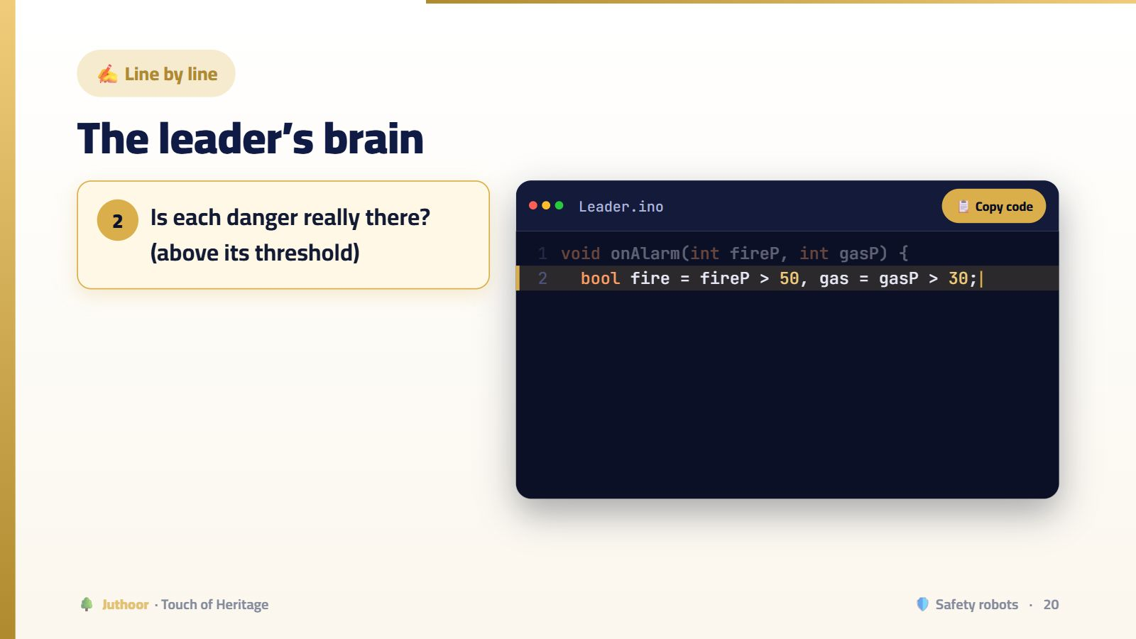
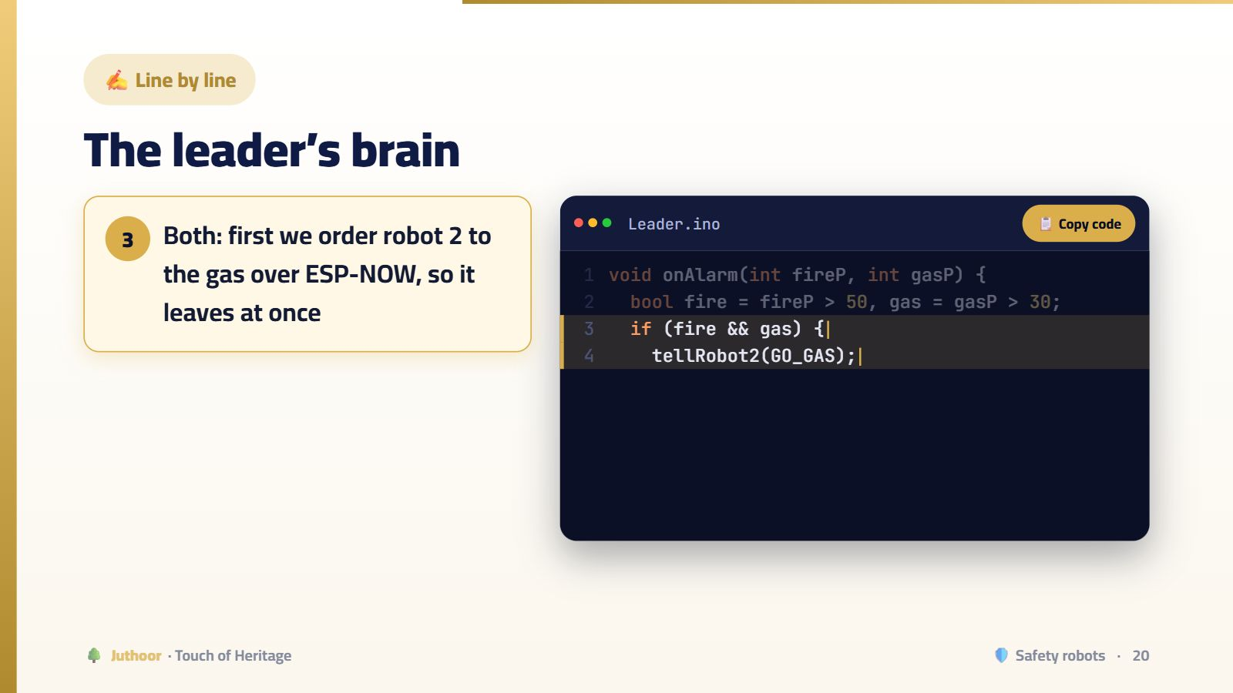
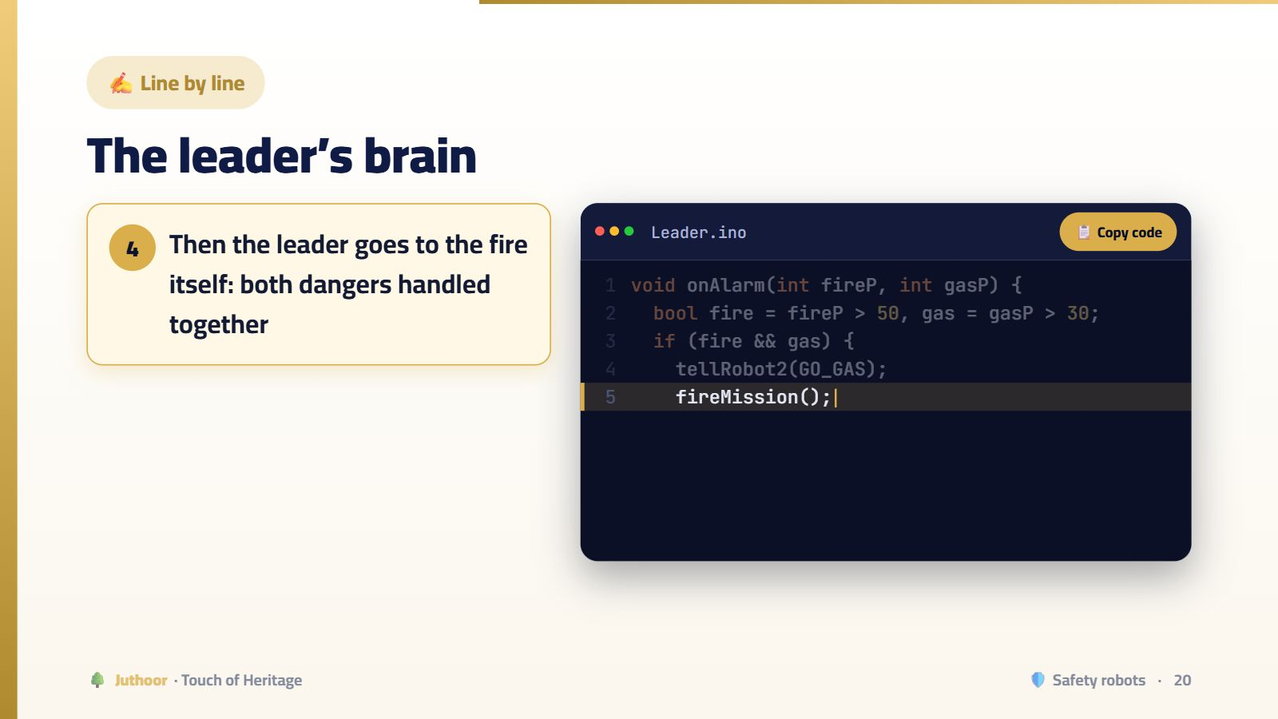
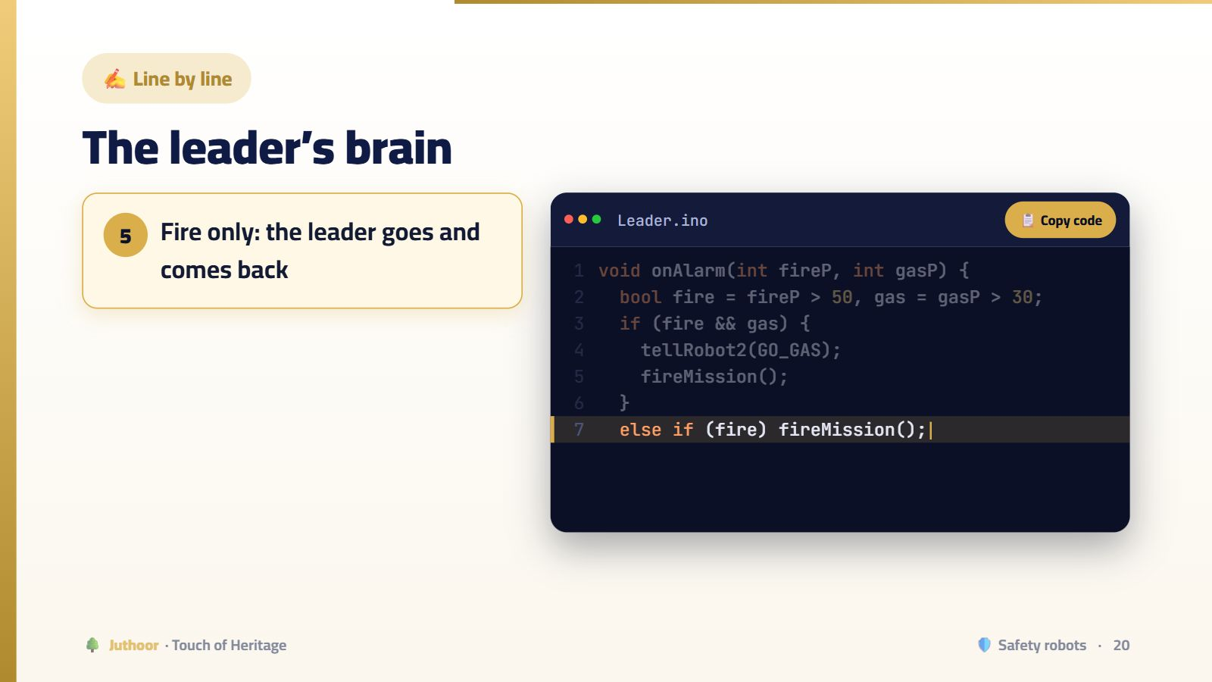
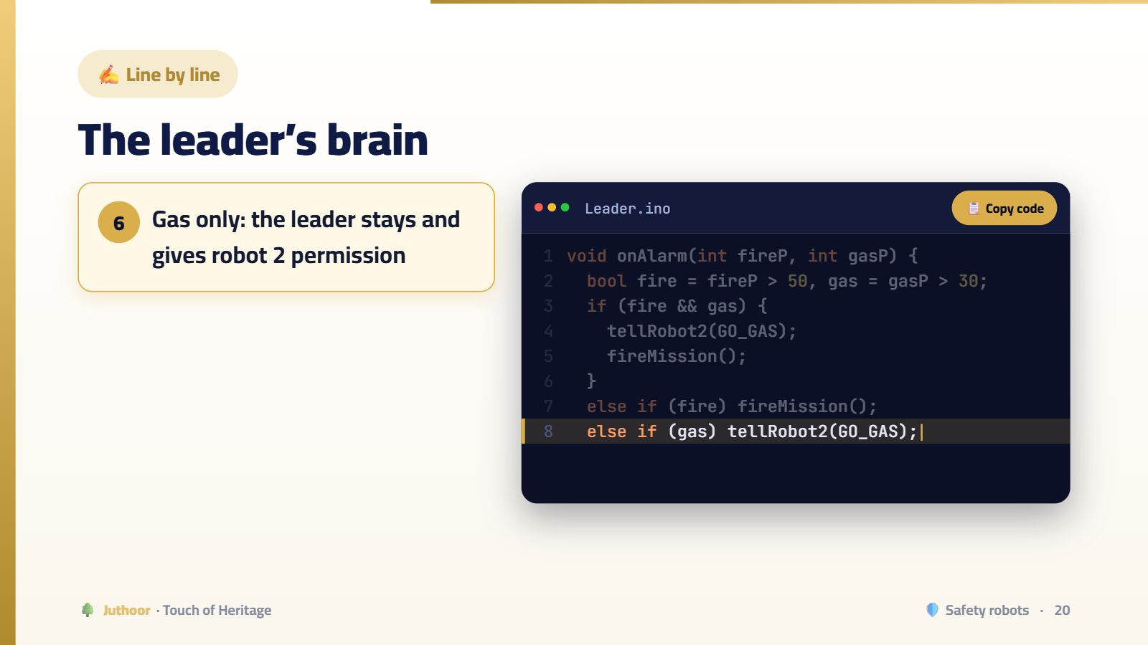
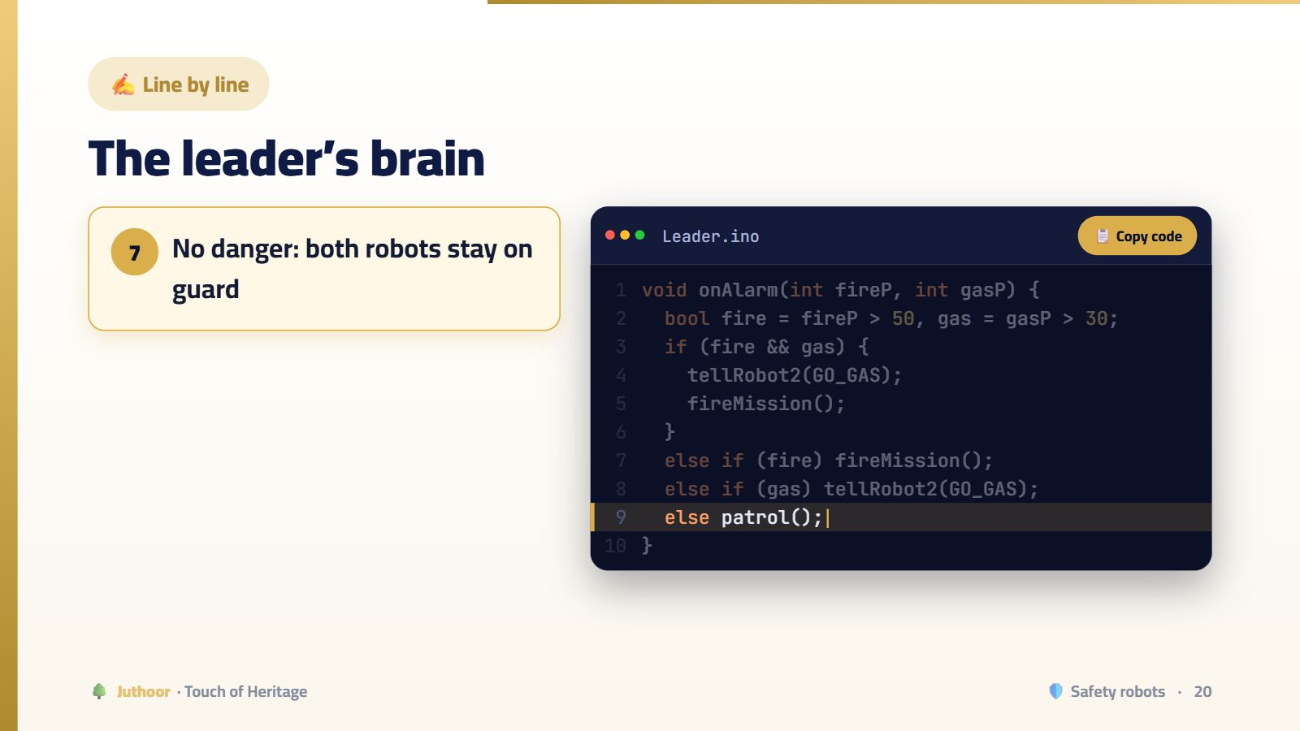
Notes:
Why order robot 2 before moving? The fire mission takes time; if we told robot 2 afterwards, the gas would wait for nothing. The order of two lines saves precious seconds.
🖱️ اضغط للانتقال بين الخطوات.

Slide 21

Notes:
Start with “Fire A”: the leader (red) goes itself, puts out the fire, then backs up the same way, while robot 2 (blue) keeps guard. Then “Gas B”: the leader stays and sends a permission message to robot 2, which goes, runs the fan and returns. Then “Both”: gas in A and fire in B — the leader sends the order to robot 2 and sets off to the fire; they work at the same time, pump here and fan there, then each one returns to its place.
💡 هذه الأداة تفاعلية بالكامل في منصة جذور، فاعرضها من المنصة إن أمكن.

Slide 22








Notes:
And robot 2? It waits for the GO GAS message from the leader, then goes to the gas, runs the fan and backs up the same way. The decision belongs to the leader; the work is shared by both.
🖱️ اضغط للانتقال بين الخطوات.

Slide 23






Notes:
Click step by step. Normally the screen says the museum is safe. When a fire starts, the screen turns red and announces “FIRE ALERT” with its level, then “Robots on their way”, then “Civil Defense notified”. Once the fire is out and the robot is home: “Mission complete”, then “Museum is SAFE now”. The pages flip by themselves every two seconds, like an advert board.
🖱️ اضغط للانتقال بين الخطوات.

Slide 24




Notes:
This phone plays the role of the Civil Defense phone. The moment a fire is detected, the station itself sends a Telegram message with the type of danger, its level, and that the robots are handling it. When the fire is gone and every robot is back home, a second message arrives: “The museum is safe, no need to come.” Read both messages aloud to the judges; even better, let a real phone ring in front of them.
🖱️ اضغط للانتقال بين الخطوات.

Slide 25

Notes:
Each rule answers a “what if?”: what if the fire does not go out? What if the link drops? What if a message is lost? This is how engineers design real safety systems.
💡 هذه الأداة تفاعلية بالكامل في منصة جذور، فاعرضها من المنصة إن أمكن.

Slide 26


Notes:
Let the scene run: the leader and robot 2 spray, but the fire keeps growing. The time limit (30 seconds) ends, so the leader decides by itself that it needs help and sends a Telegram message: “We could not control the fire… urgent support needed”, then both robots back away safely. The firefighter arrives with two more robots: robot 3 carries a hose and an ESP32-CAM streaming the fire to the laptop; robot 4 carries a hose only. He opens his hand at the laptop camera and they advance; he makes a fist and they stop and spray; he moves the fist right and left and the hose rises and lowers. The fire goes out, and a second message arrives: “The museum is safe.”
🎬 المشهد يتحرك وحده أثناء العرض، وهو تفاعلي بالكامل في منصة جذور.

Slide 27

Notes:
The core idea for a security exhibition: autonomous robots that know their limits and ask for help, and a human who leads other robots from a safe distance without approaching the fire.
💡 هذه الأداة تفاعلية بالكامل في منصة جذور، فاعرضها من المنصة إن أمكن.

Slide 28







Notes:
A real independent decision: the robot measures, compares with its limit, and decides the mission is bigger than itself. Knowing your limits is part of safety.
🖱️ اضغط للانتقال بين الخطوات.

Slide 29


Notes:
Try the buttons, or let the auto demo run: open hand and both robots advance, fist and they stop and spray, fist right and the hose rises, fist left and it lowers. The water puts out the fire faster when the hose is at the right angle. The picture on the laptop comes from the ESP32-CAM on robot 3.
🎬 المشهد يتحرك وحده أثناء العرض، وهو تفاعلي بالكامل في منصة جذور.

Slide 30








Notes:
Each command is one letter flying over the network to both robots, just like the eye commands of the Masmak model. And no hand means stop: safety first.
🖱️ اضغط للانتقال بين الخطوات.

Slide 31

Notes:
Judges love this table more than a feature list: it shows the team really built, made mistakes, understood, and fixed them.
💡 هذه الأداة تفاعلية بالكامل في منصة جذور، فاعرضها من المنصة إن أمكن.

Slide 32

Notes:
Thank you. We welcome your questions.
💡 هذه الأداة تفاعلية بالكامل في منصة جذور، فاعرضها من المنصة إن أمكن.

